Slide 1
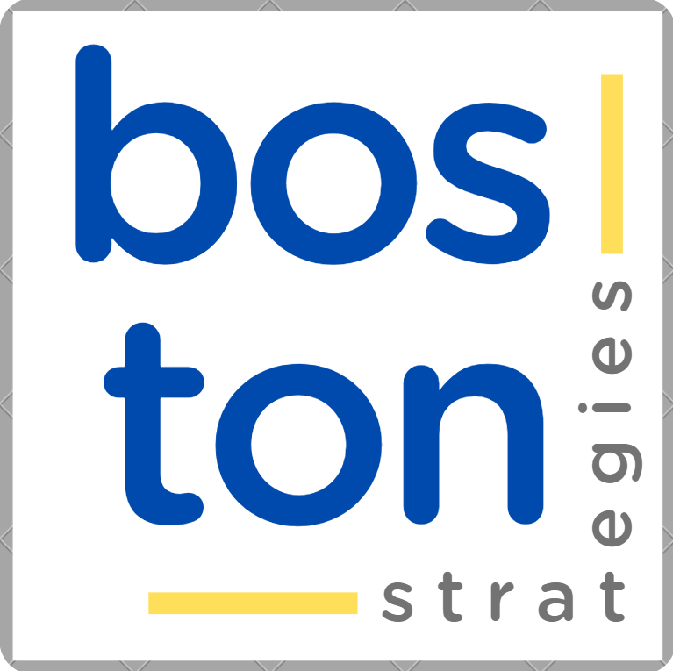

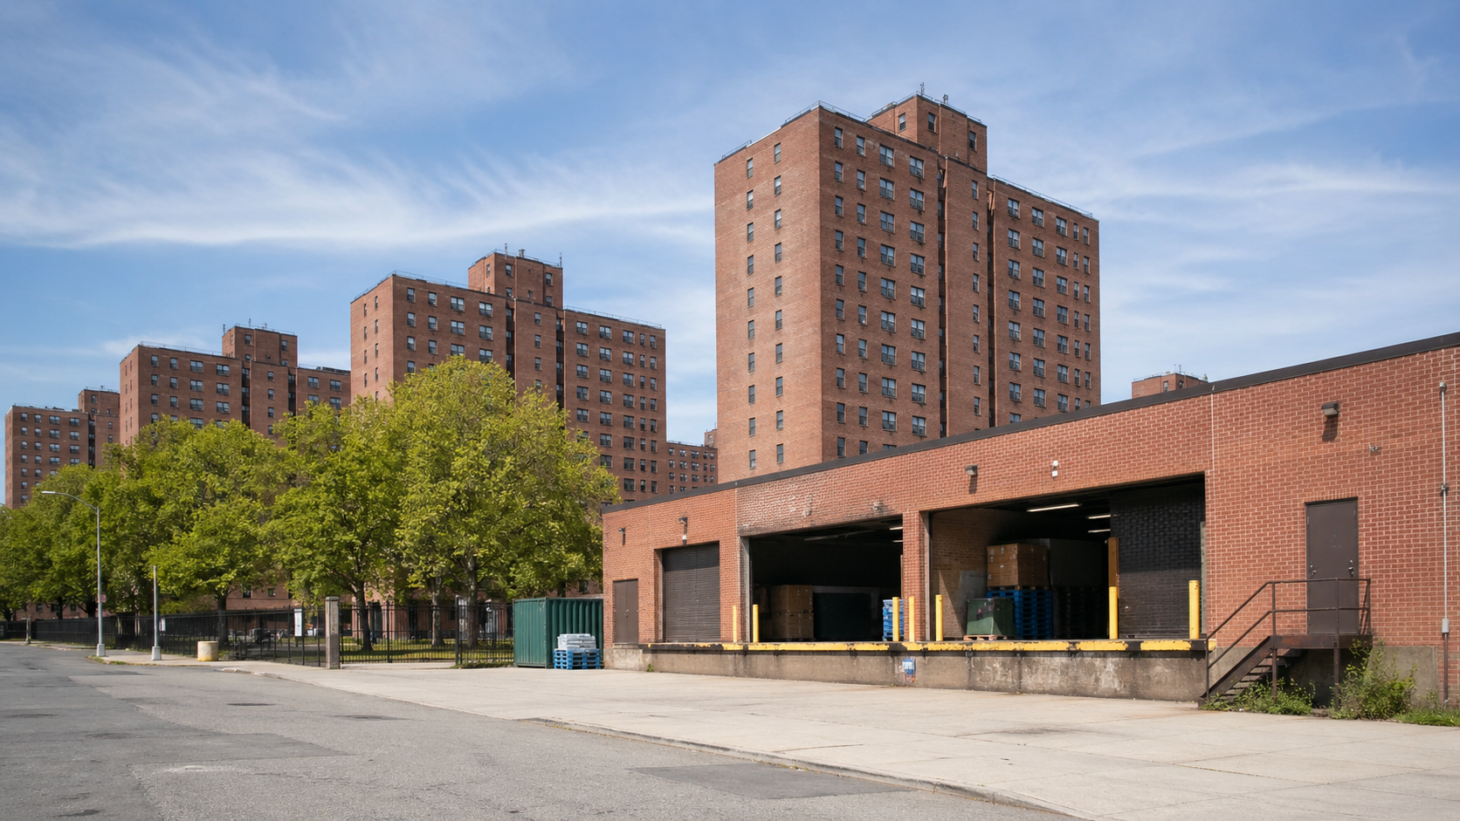
CASE
STUDY 499
SUPPLY CHAIN COST & WAREHOUSING OPTIMIZATION
ABOUT THE CLIENT
Industry | Public housing
Contract Value | $ 90,000
Employees | 12,500
Location | New York
BSI Service or Solution | Supply Chain Advisory
Key Challenges The client needed to quantify and model end-to-end supply chain costs and operations. Alternative warehousing scenarios had to be compared to determine the most efficient degree of centralization. The preferred option needed to balance total cost with high customer service. | Why BSI was Selected Expertise in supply chain cost modeling and operations analysis. Ability to audit current operations and identify management-practice gaps. Experience translating complex findings into practical recommendations and decision-ready reports.
Project Scope Baseline current supply chain costs, flows, unit costs and service levels. Evaluate decentralized warehousing scenarios against cost and service objectives. Identify resource, competency and best-practice implications for each option. | Project Approach Compiled a baseline model of current supply chain costs. Mapped flows, unit costs and service levels across the operation. Evaluated the costs of several decentralized scenarios. Audited current operations and documented findings with graphics, diagrams and supporting tables.
Financial Benefits Realized Developed a cost model to compare centralized and decentralized warehousing options. Recommended enhancements, programs and strategies to reduce procurement and warehousing costs. | Operational Benefits Realized Identified the option that best balanced total cost and customer service. Highlighted gaps in management practices and best practices that could improve performance in either system.

Slide 2
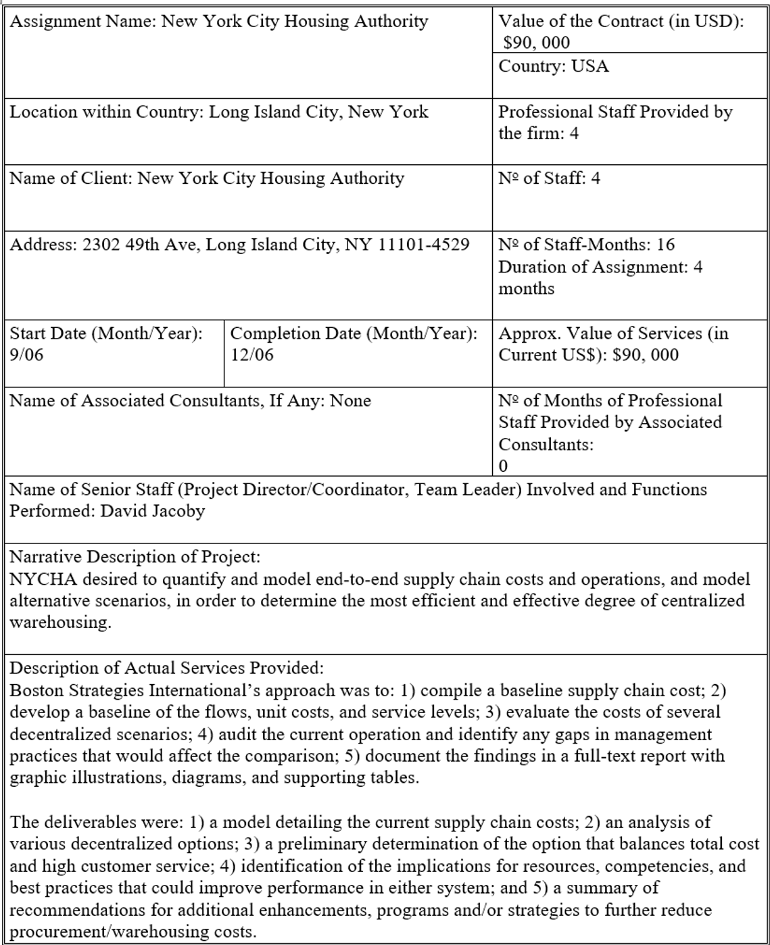

2
Notes:
Grandes Proyectos de Capital
Grandes proyectos de inversión que no cumplan con la tasa de retorno esperada
Apertura de mercados, reformas o desregulación que requiere capacidad elevada de procura
Nuevos requisitos técnicos estrictos que requieren evaluación de tecnologías alternativas
Diversificación en negocios relacionados con diferentes dinámicas del mercado de suministro
Beneficios Económicos Tangibles
Análisis de mercado personalizado para productos y servicios de alta ingeniería
Soporte a las negociaciones de contratos
Asesoría y capacitación en contratación (esp. Diseño y gestión de licitaciones)
Planificación Estratégica y optimización de Cadenas de Valor
La mejora de procesos
“50x” Retorno a la inversión
50% reducción en ciclos de tiempo
20-30% incremento en márgenes de ganancia
50+ veces es el retorno a la inversión en nuestros servicios de consultoría

