Slide 1
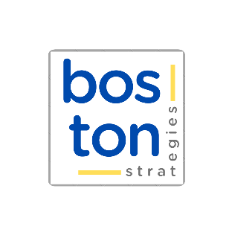


CASE
STUDY #498
“Market Repositioning Implementation” Case Study
“I’ve never seen such incontrovertible logical basis for management advice."
– Deputy Managing Director
ABOUT THE CLIENT
Industry | Water Treatment
Location | Saudi Arabia
BSI Service or Solution | Business Strategy
Key Challenges Client lacked the specialized resources to develop and market a product line for a highly engineered solution. Client didn’t have contacts at the top international suppliers in the target market. Client needed assistance developing technical sales material and case studies for the target market. Client wanted help with the registration and approval process at key target accounts. | Why Boston Strategies was Selected International expertise in specialized segments of the pumps, valve, and fluid treatment solutions business. N Capability to deploy a team of 5 to 10 senior consultants in Saudi Arabia for one to two years. Proven track record in delivering results that exceeded expectations at the holding company.
Project Scope Industrial and municipal water treatment solutions Chemical, ultraviolet, mechanical, and other high-precision and cutting-edge technologies Process control systems and components High-pressure and oversized pumps High pressure, high temperature, and ultra high precision valves | Project Approach Targeted development of unique skills in the client organization Writing of technical white papers Redesign of the organization, starting with new hires in key positions including the President and progressing through phases of growth Development of supply chain partnerships Registration and qualification at target customers Guidance in sales efforts to target customers Budgeting and forecasting, including CapEx and staff
Operational Benefits Realized Revitalization of the organization Capability to address market needs with complex and highly engineered solutions Step-by-step roadmap for multi-year growth | Financial Benefits Realized Balanced growth across product lines and market segments Profitable cost structure even at early stages Limited capital investment and modest debt levels

