Slide 1


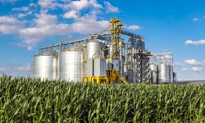
CASE
STUDY 497
Policy Working Group Management
ABOUT THE CLIENT
Industry | Development Bank
Assets Under Mgmt. | $100 billion
Employees | 12,000
Location | Global
BSI Service or Solution | Policy Advisory
Key Challenges World Bank sectoral loan was up for review. Subsidies needed to be progressively reduced as part of the incoming government’s liberalization plan. | Why BSI was Selected Competence in supply chain economics. Experience facilitating diverse working groups. Capability to lead working groups and produce deliverables in French and English.
Project Scope Sectoral Adjustment Loan covered hard wheat, soft wheat, barley, dates, potatoes, olives and citrus products. Economic analysis covered all regions and all supply chain tiers. | Project Approach Interviewed diverse stakeholders, including farmers, producers, and government officials to decompose the tradable and non-tradable costs to arrive at the Domestic Resource Cost as a basis for subsidy liberalization. Decomposed economic aspects of inputs (e.g., fertilizers, seeds, etc.) and outputs (e.g., hard wheat). Benchmarked internal and external prices. Quantified Tunisia’s comparative advantage of agricultural production for government subsidy reallocation decisions by applying a “domestic resource cost” methodology.
Financial Benefits Realized Progressive removal of subsidies to appropriate ”strike price” levels enabled the sector to become globally competitive. National economy grew as an indirect result. | Operational Benefits Realized Efficiencies realized upstream (seeding, harvesting) and downstream (refining, distributing). Stakeholder awareness and alignment regarding the transition toward reduced and more tailored subsidies.

