Slide 1

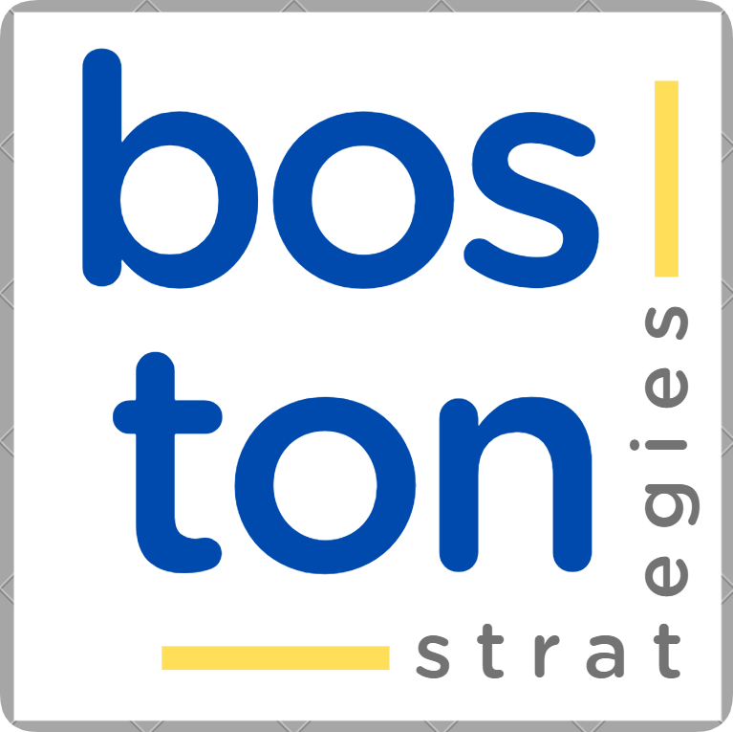
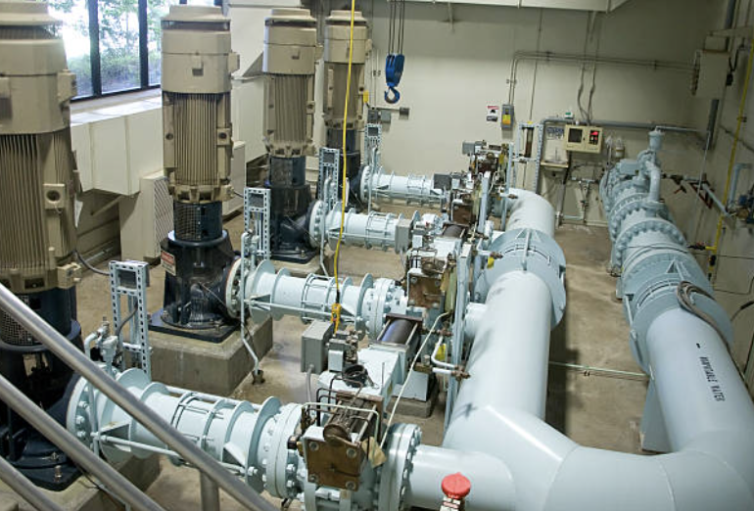
CASE
STUDY 493
Supplier Competitive Analysis & Contracting Strategy
“Long-Term Contracting Due Diligence for Strategic Partnerships”
ABOUT THE CLIENT
Industry | Water Treatment
Revenues | $20 billion
Employees | 330,000
Location | Germany and USA
BSI Service or Solution | Contracting Best Practices
Key Challenges Contracted equipment was delivered but was faulty and exploded, causing direct and indirect damages. The supply chain partners involved argued in court about which of them was responsible, and to what degree. Two parties disputed the existence and the validity of certain contract terms and conditions (T&C), especially liability and liquidated damage clauses. | Why Boston Strategies was Selected Expertise in contracting and contract risk management Familiarity with the water treatment industry and with the suppliers involved in the dispute Knowledge of standard industry practices for contracting multi-year, complex, engineered construction projects
Project Scope External and intra-company tendering procedures, including RFI, Request for Proposal, and contracting Contract terms and conditions, notably liability for damages and liquidated damages for remediation and penalties Belt Dryer Sludge Storage Bin Odor Control System Extruder | Project Approach Benchmarked the contracting process against standard contracting procedures, across industries Defined standard and best practices at each stage of contracting, identifying practices that led to ambiguity such as links to T&Cs, different versions of the contract T&Cs, ambiguous intercompany procedures, and email and other off-line communications vs. what was in the contract proper.
Financial Benefits Realized Helped to resolve a $7 million intra-company dispute that had gone on for seven years Avoided the costs and distraction of prosecuting the case in court, which was upwards of $1 million | Operational Benefits Realized Helped the client define clearer intra-company standard operating procedures regarding contracting, to avoid similar disputes in the future

