Slide 1
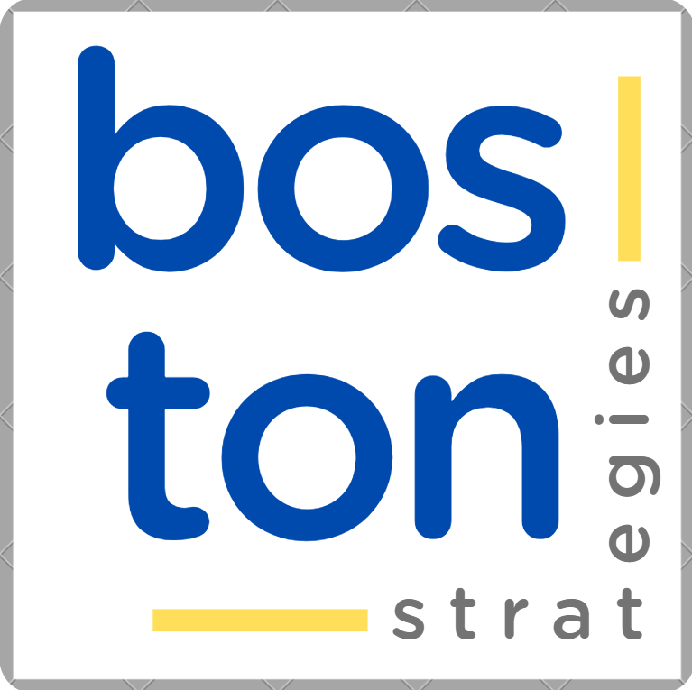
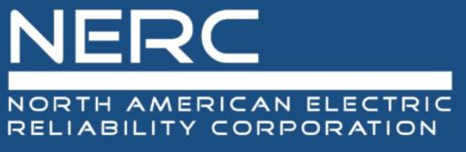
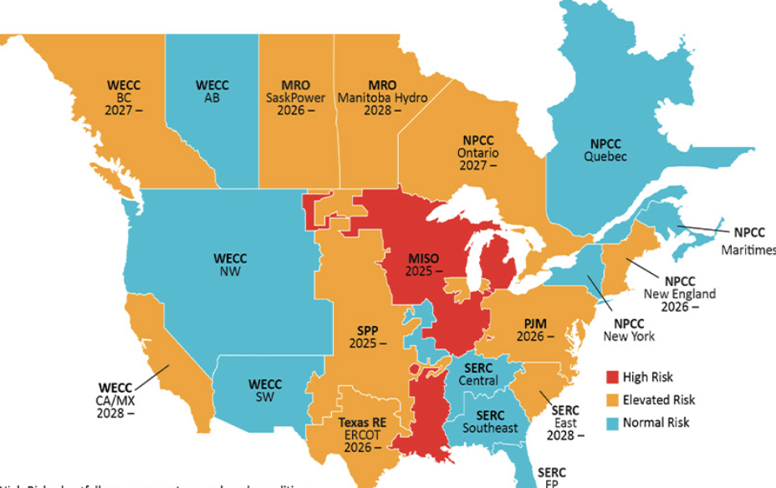
CASE
STUDY 490
“Mitigate cyber-security breaches and supply chain risks by implementing provenance best practices”
ABOUT THE CLIENT
Industry | Energy
Revenue | $100 million
Employees | 200
Location | Atlanta, Georgia, U.S
BSI Service or Solution | Risk Management
Key Challenges Hardware and software components with unverified provenance posed risks of counterfeiting. Lack of chain-of-custody documentation made it difficult to track changes or identify malicious actors. Risks from insiders, nation-states, and cybercriminals exploiting gaps in procurement and maintenance processes. Existing standards required stronger implementation guidance to address threats. | Why Boston Strategies was Selected Proven track record in developing provenance frameworks aligned with NIST, ISO, and FERC guidelines. Deep understanding of CIP-013 and NERC compliance requirements. Ability to integrate physical and logical controls into a unified strategy. Experience working with utilities, vendors, and federal agencies to standardize best practices.
Project Scope Drafting guidelines for provenance management across planning, development, installation, maintenance, and disposal. Establishing contract language to mandate SBOMs, multi-factor authentication, and patch verification. Implementing controls like denied-party screening, secure development environments, and trusted communication paths. Creating resources for NERC members to operationalize the framework. | Project Approach Mapped provenance risks across the BPS lifecycle (Table 1.1 from NERC guidelines). Adapted NIST IR 7622, ISO 20243, and CIP-013 recommendations into actionable steps. Tested controls with utilities and vendors, focusing on high-risk areas (e.g., patch management). Expanded the framework to all NERC regions, supported by training and metrics for continuous improvement.
Operational Benefits Realized Achieved 100% SBOM adoption among critical vendors, improving traceability. Denied-party screening prevented contracts with 15+ high-risk entities. Cryptographic patch verification eliminated malware incidents from updates. | Financial Benefits Realized Reduced incidents of counterfeit components, saving an estimated $2M+ in potential breach remediation. Streamlined adherence to CIP-013, avoiding penalties and audit findings.

