Slide 1


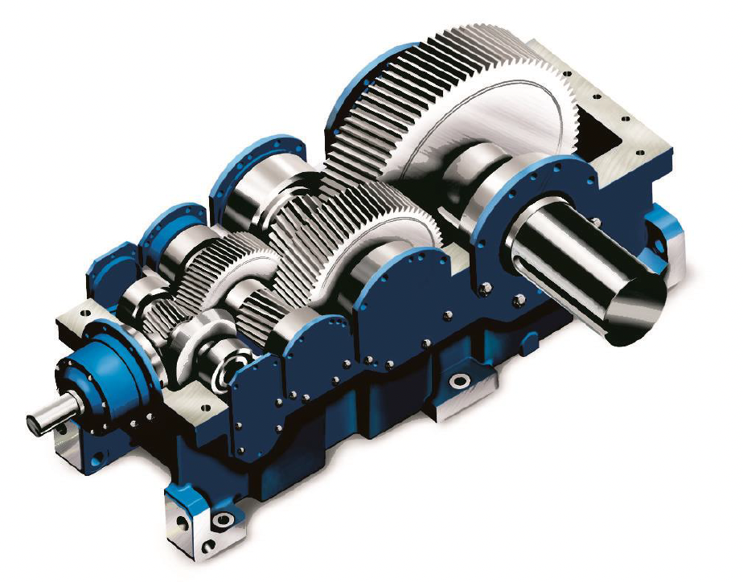
CASE
STUDY #489
Case Study: “Local Value Added”
“We are happy with the coverage and insights, and especially the strategic
implications and recommendations, which are specific and actionable.”
ABOUT THE CLIENT
Client | Value-Added Distributor
Revenues | $60 million
Employees | 15
Location | India
BSI Service or Solution | Market Outlook and Business Strategy
Background and Key Challenges India’s Make-in-India program was expected to generate a high volume of foreign direct investment and buoy the manufacturing sector. The energy sector was poised to be a significant beneficiary of the industrial growth. However, the client lacked specific knowledge of the value chains for high-value components and services. | Why Boston Strategies was Selected High-quality, in-depth, data-rich report structure Intimate knowledge of energy transition and supply economics Prior knowledge of the equipment categories Longstanding presence in India
Project Scope Gearboxes, couplings and wheels for wind turbines ID/FD Fans for solar panel substrate processing Slewing Bearings for wind turbine generator. Rotation Graphite Electrodes for battery storage systems Compressors for natural gas derivative production EOT, Bridge, Gantry, Jib, Tower and Mobile Crane Components including Barrel Couplings, Sheaves, and Hooks & Blocks All analyses were specific to the Indian market. | Project Approach Demand Drivers, Trends, Largest Consuming Industries, Demand History and Forecast Total Capacity, Capacity Utilization, Top 10 Suppliers, Potential New Entrants, Barriers to Entry and Exit Order Lead Times, Analysis of Cost Drivers, Cost Trend and Forecast Profit Margins, Price Forecasts, "Should-Cost" Analysis, Discussion: Recent Contracts, Trends and Changes in Industry Structure; Substitutes, Technological Innovations; Manufacturing Strategies and Key Success Factors
Operational Benefits Realized Expansion into related industries in India Anticipated expansion in the Middle East Focused acquisition in the United States | Financial Benefits Realized Tripling of revenue in three years Targeted 10x growth by 2030

