Slide 1


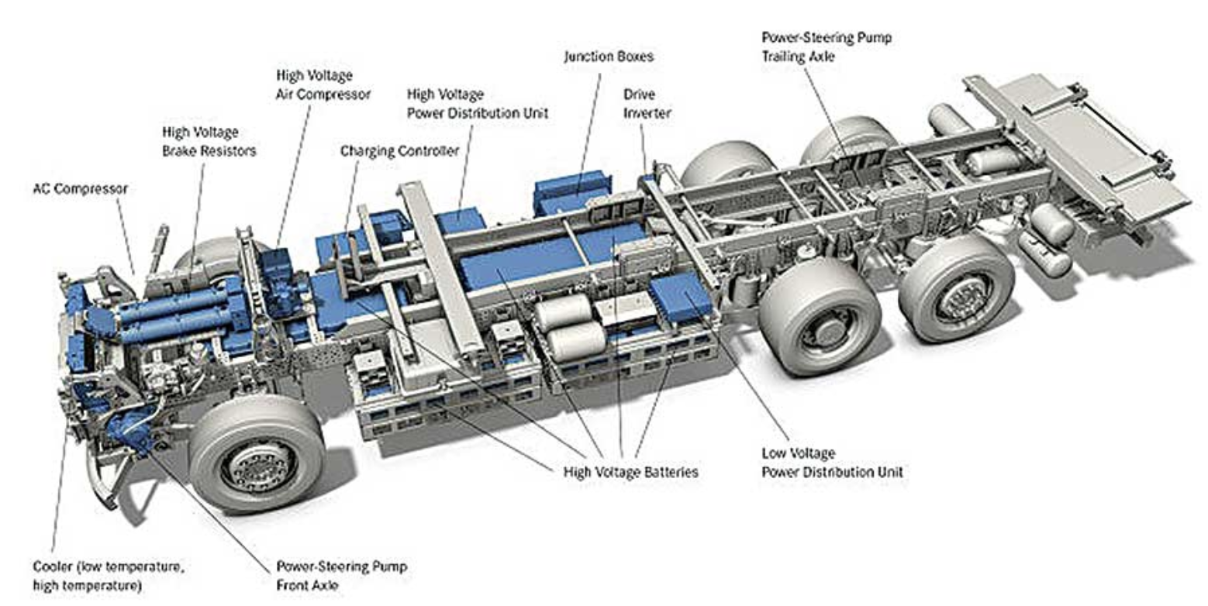
CASE
STUDY #488
Case Study: “Vehicle Manufacturing Process Optimization”
“30-50% reduction of lead time, 50% cost reduction, and zero quality defects”
ABOUT THE CLIENT
Client | Top Tier Car, Truck and Bus OEM
Revenues | $150 billion
Employees | 175,000
Location | Brazil
BSI Service or Solution | Performance Improvement
Key Challenges Mercedes-Benz do Brasil imported heavy duty truck parts in crates and assembled them in Brazil. The Completely-Knocked-Down (CKD) truck model should have been very efficient but its actual implementation was slow, cumbersome, and costly due to delays at the port and customs, overly burning some processes for inspections and quality approvals, and insanely bureaucratic paperwork. The ship sailing schedules created lumpy production schedules and the process inefficiencies created an in flexible and high-cost situation. | Why Boston Straegies was Selected Boston Strategies staff was on the Kearney consulting team, which had established a reputation for delivering extraordinary cost reduction through optimizing logistics processes. Portuguese language skills. Daily work was conducted in Portuguese.
Project Scope Packaging in Malaysia Malaysia to Brazil ship sailings Customs clearance Inspection and quality control Transportation Unpacking and assembly logistics Production scheduling | Project Approach Optimizing the packing of the vehicles in Malaysia Considering the shipping schedules from Malaysia to Brazil. Mapped the processes of customs clearance Dramatically simplified the processes Cut the time for parts to clear customs and get to the warehouse. Simplified inspections and quality approval as well as records filings. The project, which was conducted in Portuguese, involved significant engagement by all the departments across the process, since each department could create a bottleneck that would affect the other areas.
Operational Benefits Realized 30-50% reduction of lead time Zero quality defects | Financial Benefits Realized 50% reduction of cost (targeted)

