Slide 1
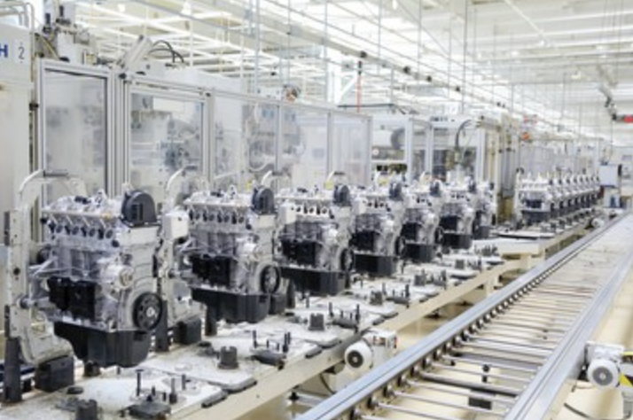

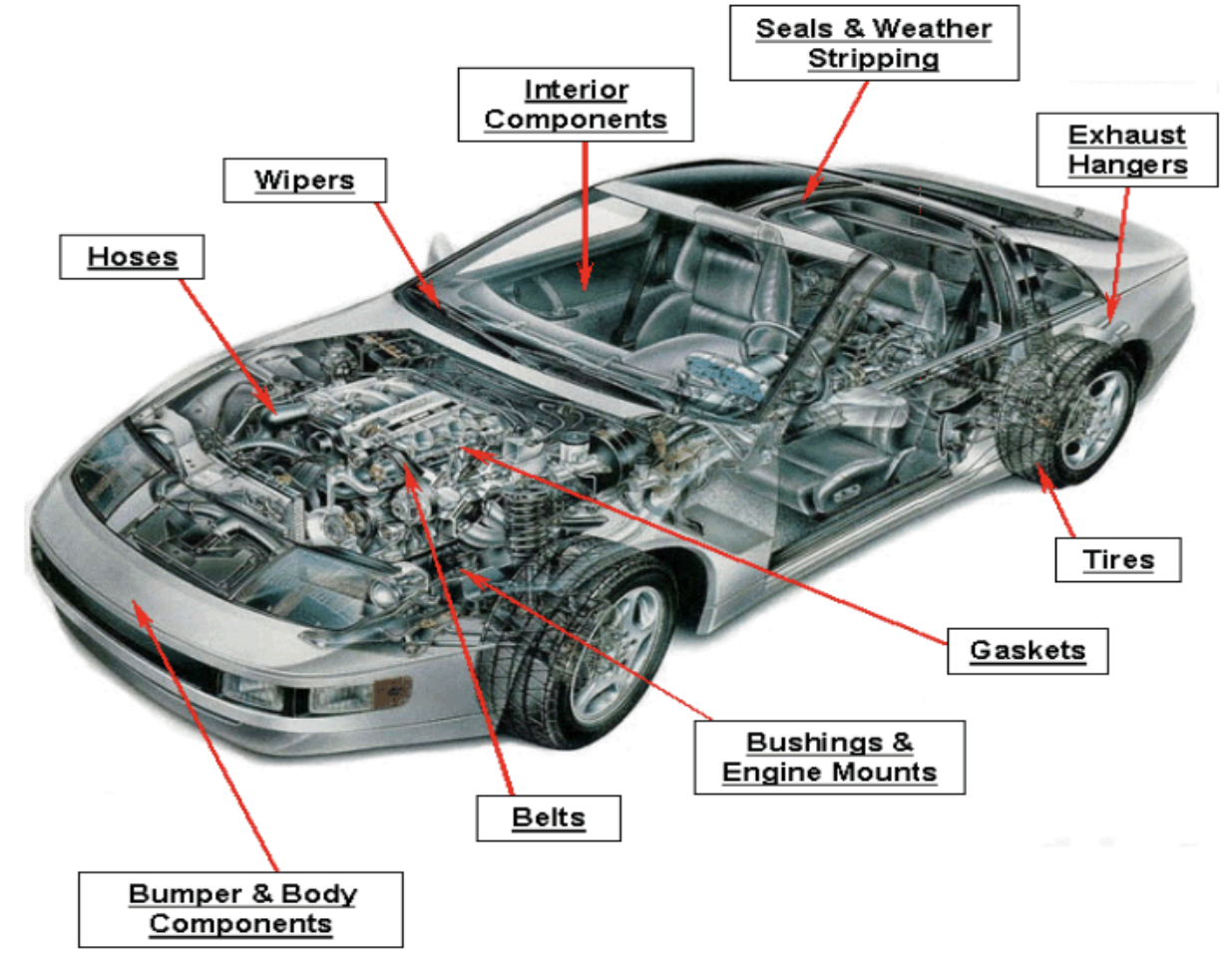
CASE
STUDY #487
Case Study: Vehicle Parts & Components Sourcing
“Savings of 40-70% on most parts, and 25-30% on the weighted average cost of purchased parts”
ABOUT THE CLIENT
Client | Top Tier Automotive OEM
Revenues | $180 billion
Employees | 700,000
Location | Brazil
BSI Service or Solution | Performance Improvement
Key Challenges The Brazilian internal market had inflated cost levels after decades of protectionism. The Brazilian government launched a reform initiative to become more competitive by lowering tariffs. General Motors do Brasil had a one-time opportunity to take advantage of a reduction in Brazil’s tariff level. It undertook an enterprise-wide sourcing program for direct materials and parts from around the world, which were in many cases far less expensive than their Brazilian made counterpart. | Why Boston Strategies was Selected Boston Strategies staff was on the Kearney consulting team, which had established a reputation for delivering extraordinary cost reduction through sourcing and supply management. Portuguese language skills. Daily work was conducted in Portuguese.
Project Scope In-depth technical and economic comparisons on a part-by-part level Strategic sourcing (supplier identification, vendor qualification, specification development, value engineering, supply chain strategy, RFI, RFP, bidders conference, RFQ, negotiation in rounds, contracting, supplier transition) Weekly approvals in the C-Suite | Project Approach Structured a robust process for review of every single part in a vehicle. Implemented the change through every department from engineering to finance to IT. Switched suppliers in many cases. Back-leveraged existing suppliers’ prices in order to meet the world price.
Operational Benefits Realized Transformation of the entire supply base Savings of 40-70% on most parts, and 25-30% on the weighted average cost of externally purchased parts | Financial Benefits Realized Dramatic reduction in the cost of the vehicle Remarkable improvement and profit for GM do Brasil General Motors worldwide adopted the program in Europe, the United States, and Australia.

