Slide 1
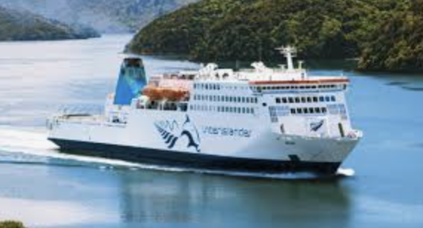
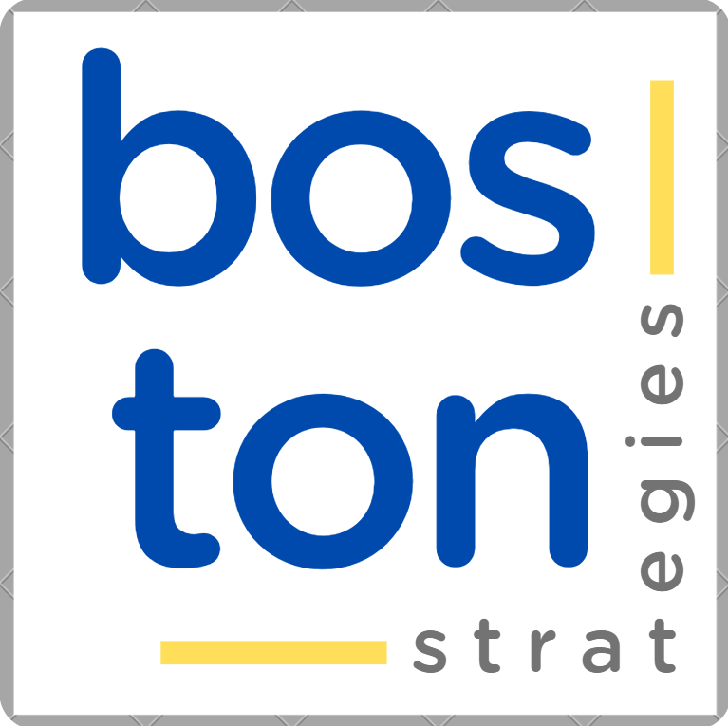
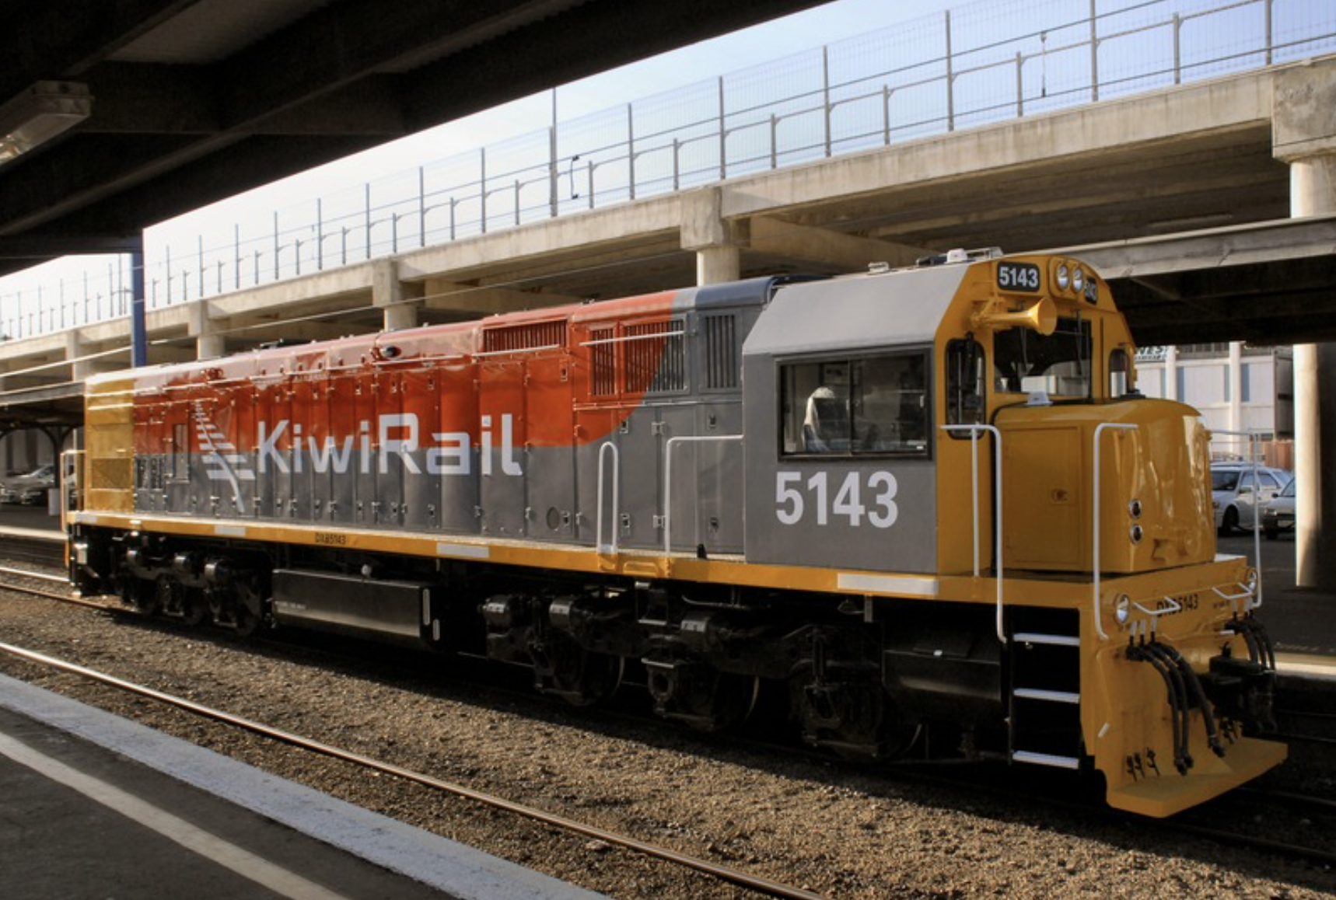
CASE
STUDY #486
Case Study: “Rail , Ferry and Intermodal Valuation for M&A Transaction”
“…a thorough and well-documented analysis that supported the identified transaction price" -- Client
ABOUT THE CLIENT
Client | CS First Boston
Assets Under Management | $1.39 trillion
Location | New Zealand
BSI Service or Solution | Transaction Advisory
Key Challenges The Crown had decided to privatize the national railroad and hired an investment bank to handle the transaction. The investment bank hired a consultant to determine the correct valuation. | Why Boston Strategies was Selected Prior experience with rail and trucking merger and acquisition transactions Prior experience with railroad regulatory policy-setting, notably of the unbundling of right-of-way assets from operating rights Intellectual property including published articles on management best practices in transportation industries
Project Scope Assess management organization and processes Evaluate potential for improvement and maximizing the valuation Suggest scenarios for complete valuation analysis | Project Approach Assessed the Business Plan and quantified expected sales price. Interviewed senior executives to determine realism of management projections. Analyzed customer profitability and the profitability of each line of business, and of the right-of-way separate from the operations. Developed scenarios to sell, “run down,” or break up the railway, estimating sales revenue for the government’s Treasury in each case.
Operational Benefits Realized Prepared the asset for disposition after years of debate A quick sale launched the next era of privatized rail operation. | Financial Benefits Realized The actual sale was valued at exactly the amount that the analysis revealed, validating the quality of the assessment and of the valuation.

