Slide 1
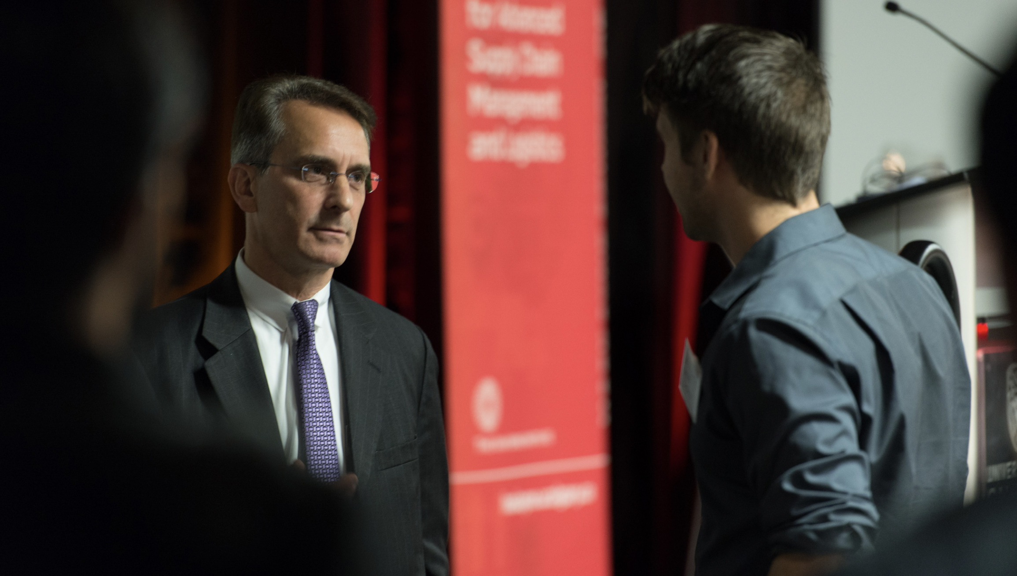

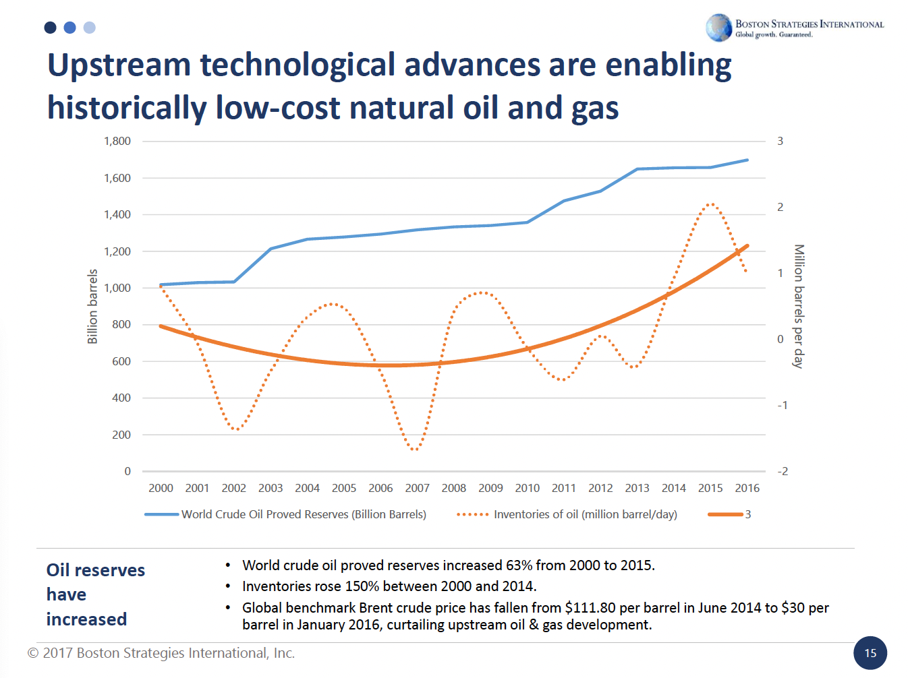
CASE
STUDY #483
Case Study: “Energy Mix and Renewables Forecasts”
“I would recommend this [research and analysis] to my colleagues; the content was helpful and worth my time." -- 94% of all attendees
ABOUT THE CLIENT
Industry | Leading University
Alberta Energy Industry | $119 billion
Students | 34,000
Location | Calgary, Alberta
BSI Service or Solution | Education, Training & Policy
Key Challenges Calgary’s traditional strength in conventional fossil fuel exploration and production, especially heavy oil in tar sands. In light of the energy transition, the province questioned which energy technologies would become adopted in the province, and what the impact on its native oil industry would be. The University sponsored large, inclusive events to educate and stimulate debate. | Why Boston Strategies was Selected Global energy industry management and advisory (consulting) experience Academic frameworks and methodologies based on published articles, books and courseware Proprietary econometric models, including simulations covering energy supply chains over 50 years and many business cycles
Project Scope Keynote address at a luncheon dedicated to exploring the issue Explanation of underlying cost and demand drivers Forecasts for Calgary, Alberta, and all of Canada in a changing global energy landscape Policy implications Q&A with active engagement and dialogue regarding conventional and renewable technologies | Project Approach Researched Alberta and Canadian energy production, consumption and trade over time Quantified rates ($/kWh) and costs of conventional and alternative energy technologies Forecast supply, demand, rates and prices by energy technology Identified corporate and stakeholder strategies to profit from the trends
Operational Benefits Realized Forum for aligning diverse stakeholders Basis for policy formulation that could stimulate job retention and growth | Financial Benefits Realized Profiled subsectors with high ROI potential in future energy scenarios, such as UAVs, Radar/LIDAR, Intrusion Detection via Image Pattern Recognition, Infrared Imaging, Smart Pigging, Magnetic Flux Leakage, Ultrasonic Tools, Geometry Tools, Distributed Fiber Optic Sensing, Acoustic Sensors, Temperature and Strain Sensing, Electric Field Mapping, Pipe Coating, Lining and Cathodic Protection, and Cyber-Secure Networks

