Slide 1

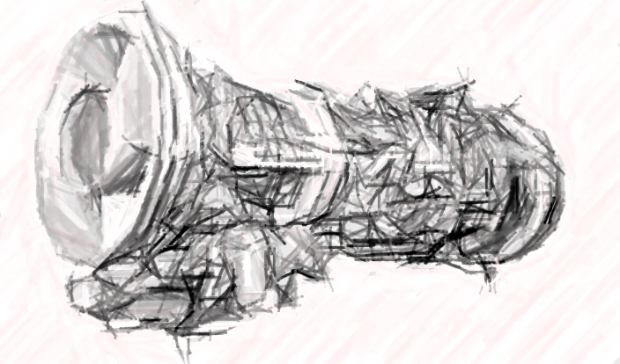
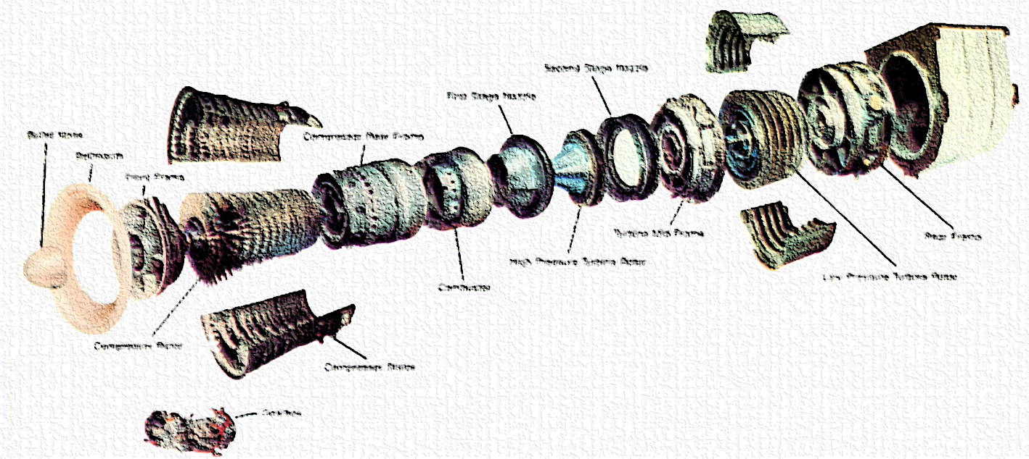
CASE
STUDY #477
Case Study: “Renewable Power Maintenance Strategy”
“This project gave clarity about the market size and trends, the competitive gaps, the acquisition targets that could fill those gaps, and the cost of being a successful significant player in the industry."
– Project Director
ABOUT THE CLIENT
Industry | Power generation and power plant maintenance (vertically integrated with third party operations)
Revenues | $1.7 billion
Employees | 4,000
Location | Saudi Arabia
BSI Service or Solution | Business Strategy
Key Challenges Share of wind and solar in the energy mix was increasing. Unclear to what extent aeroderivative gas turbines would replace gas turbines, especially for peak shaving and frequency regulation applications. Implications for both the client’s fleet of small and large turbines, and for the third-party service division. | Why BSI was Selected Region-specific knowledge of oil, gas, and power companies’ operations Deep experience in power generation equipment including turbines of all sizes Track record of accurate, specific and precise market analyses Trusted advisor regarding market entry strategy and mergers & acquisitions
Project Scope 10-100 MW aeroderivative-type gas turbines By OEM By region (specific countries in the Middle East, Africa, Central Asia ,Southeast Asia, China) By application By model By size in MW By OEM vs. third party service By component and part group | Project Approach Market Assessment based on a forecast of oil, gas and power (renewables and conventional) by size of aeroderivative GT OEM Market Share and Trend, based on a forecast of utility (developer) use by model of GT, recommending a Strategic Focus on Equipment of a Certain OEM Largest fleet owners of that OEM’s equipment, based on a forecast of utility (developer) usage, leading to Target Customer Profiles Parts & Service Strategy, esp. whether to partner with an OEM or tech provider, vs. acquire the capability via M&A Supply Chain Strategy: Recommendation of whether to refurbish OEM parts or develop unique non-OEM parts and service -> Operations Business Model List of Owners That Are or May Be Looking for Aero and Light Industrial GT Service Solutions, are dissatisfied, and/or have upcoming contract expirations
Operational Benefits Realized Acquisition price estimates allowed the client to plan for treasury operations Highly reliable plans for multi-year capital budgeting Tactical strategy for dealing with potential competitors and acquisition targets | Financial Benefits Realized $800 million revenue opportunity Presented an attractive return on investment Optimized an initial capital investment + upgrading costs to achieve market supremacy Recommended a defensible technological differentiation at scale

