Slide 1

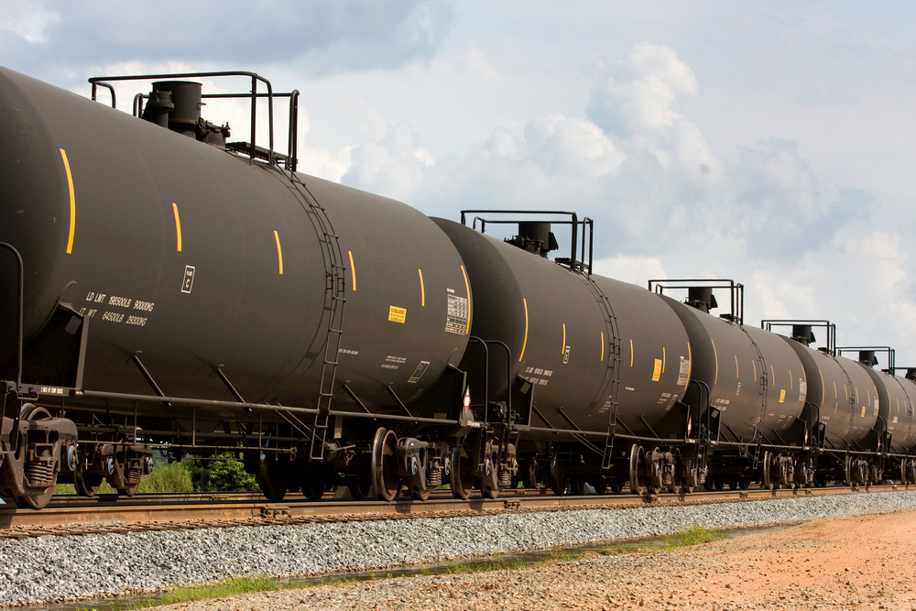
CASE
STUDY
Supply Market Capacity Intelligence and Strategy: For-Hire Liquid Bulk Storage Services
ABOUT THE CLIENT
Industry | Oil and Gas
Revenues | $200 billion+
Employees | 80,000
Location | Europe
BSI Service or Solution | Capacity & Channel Analysis
Key Challenges Capacity was constrained, leaving field support staff short of railcar storage, transloading, and tank and pipeline handling capacity. No existing resources were sophisticated or detailed enough to provide visibility to granular operational intelligence on impending midstream bottlenecks | Why BSI was Selected Expertise and experience with transloading and bulk commodity handling operations Database compilation and integration capabilities Knowledge of compliance requirements in hazardous chemicals handling and logistics
Project Scope | Project Approach Developed a nationwide database of transload facilities, tanks capable of handling each fuel, and railroad carspots Analyzed qualifying parameters such as available capacity, compliance record, and rates Compiled a database of contacts for every facility Conducted a strategic competitive analysis of large midstream suppliers
Financial Benefits Realized Increased revenue from higher throughput Reduced costs by identifying more suppliers and building a procurement information system that facilitated a more competitive tendering process | Operational Benefits Realized Revealed spots of available capacity, which increased throughput and fuel sales Increased flexibility by facilitating access to a broader range of suppliers
  Storage tank farms for bulk storage
  Railcar storage
  Trans-loading facilities (railcar to truck and vice versa)
  Ethylene, Compressed
  Ethyl Acetate
  Flammable Liquid, N.O.S.
  Acetic Acid, Solution/Glacial
  Acetic Anhydride
  Butadienes, Stabilized
  Ethylbenzene
  Xylenes
  Other Flammable and Environmentally Hazardous Liquids

