Slide 1
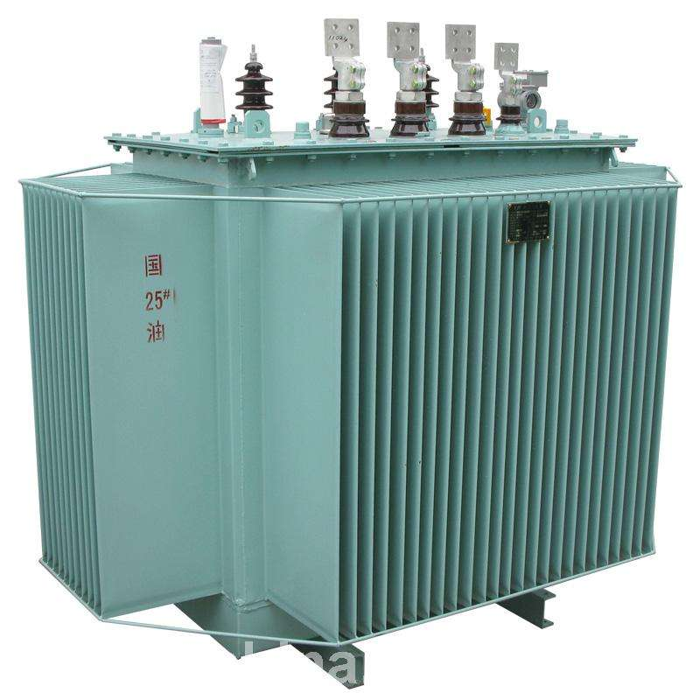
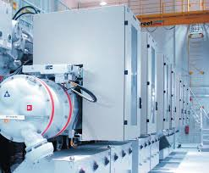
CASE
STUDY #455
Electrical Equipment Supply Market Analysis & Outlook
Supplier Competitive Analysis & Contracting Strategy
ABOUT THE CLIENT
Industry | Oil and Gas
Revenues | Hundreds of billions of dollars
Employees | Tens of thousands
Location | Middle East
BSI Product | Market Outlook
Key Challenges Long lead time complex equipment and services Potential capacity shortage Significant disparities in lead times and prices between buyers for similar products Supplier price increases above cost inflation | Why BSI was Selected Leading edge analytics Highly accurate economic forecasting model Fact-based, numbers-driven analysis Clear, simple, and objective reports Customized XML delivery format Reliable adherence to project schedule (100%)
Project Scope Transformers Switchgear Generators Motors > 500 hp Cable Lighting UPS Systems Other Electrical Distribution & Control Equipment | Project Approach Economic modeling and forecasting Primary and secondary market intelligence Sourcing recommendations Savings calculation tools Quarterly updates
Financial Benefits Realized $30-$40 million of potential hard (cash) savings through lower operating cost, lower upfront cost, lower lead time, and longer-lasting items, based on 18-month period ending in 2016. | Operational Benefits Realized Quicker delivery by identifying pockets of supplier capacity Lower inventory of repair parts & spares Less maintenance over equipment lifecycle

