Slide 1
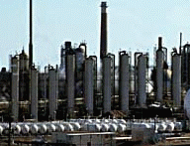
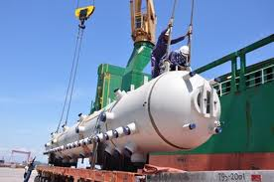
CASE
STUDY #454
Pressure Vessels Supply Market Analysis & Outlook
Supplier Competitive Analysis & Contracting Strategy
ABOUT THE CLIENT
Industry | Oil and Gas
Revenues | Hundreds of billions of dollars
Employees | Tens of thousands
Location | Middle East
BSI Product | Market Outlook
Key Challenges Long lead time complex equipment and services Significant disparities in lead times and prices between buyers for similar products Supplier price increases above cost inflation | Why BSI was Selected Leading edge analytics Highly accurate economic forecasting model Fact-based, numbers-driven analysis Clear, simple, and objective reports Customized XML delivery format Reliable adherence to project schedule (100%)
Project Scope Refinery and petrochemical reactor vessels (e.g. catalytic cracking, hydrotreating) Coke drums Distillation columns, reformers and stripper towers (e.g. demethanizers, debutanizers) Other vessels: slug catchers, knockout (surge) drums, digesters, separators, and deaerators. Tanks Chemical Injection Units (tanks, pumps, controls, valves and instrumentation, and piping) | Project Approach Economic modeling and forecasting Primary and secondary market intelligence Sourcing recommendations Savings calculation tools Quarterly updates
Financial Benefits Realized $20-$40 million of potential hard (cash) savings through lower upfront cost, based on 18-month period ending in 2016 | Operational Benefits Realized Quicker delivery of equipment by identifying pockets of supplier capacity, thereby reducing capital project critical path

