Slide 1
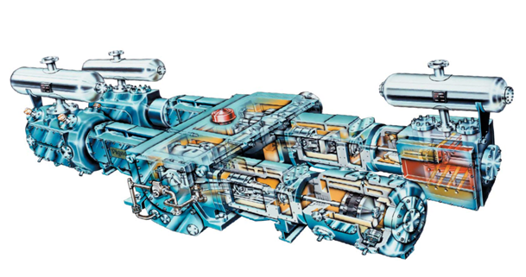
CASE
STUDY #452
Compressors Supply Market Analysis & Outlook
Supplier Competitive Analysis & Contracting Strategy
ABOUT THE CLIENT
Industry | Oil and Gas
Revenues | Hundreds of billions of dollars
Employees | Tens of thousands
Location | Middle East
BSI Product | Market Outlook
Key Challenges Critical, long lead time, engineered equipment Potential capacity shortage Supplier price increases above cost inflation Significant disparities in lead times and prices between suppliers of similar products | Why BSI was Selected Leading edge analytics Highly accurate economic forecasting model Fact-based, numbers-driven analysis Clear, simple, and objective reports Customized XML delivery format Reliable adherence to project schedule (100%)
Project Scope Centrifugal Compressors Reciprocating Compressors Process Screw Compressors Air Compressors | Project Approach Economic modeling and forecasting Primary and secondary market intelligence Sourcing recommendations Savings calculation tools Quarterly updates
Financial Benefits Realized $37-$40 million of potential hard (cash) savings through lower upfront cost, based on 18-month period ending in 2016 Higher savings 10x higher on backlog avoidance in certain prior years due to prices and demand during those business cycles. | Operational Benefits Realized Quicker delivery of equipment by identifying pockets of supplier capacity, thereby reducing capital project critical path

