Slide 1

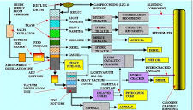
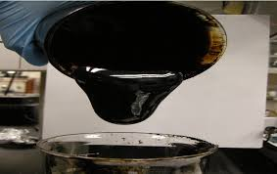
CASE
STUDY #464
Heavy Oil Conversion Technology Benchmark Outlook Study
ABOUT THE CLIENT
Industry | Oil and Gas
Revenues | $200+ billion
Employees | 65,000
Location | Middle East
BSI Service or Solution | Technology Outlook
Key Challenges Client anticipated an increasing need to process heavier crude, so needed to invest in process technologies for pre-refining and post-refining process routes for Syncrude. Project was commissioned to evaluate alternative technologies for further study and potential investment. | Why BSI was Selected Expertise in technical and commercial aspects of refining Clear communication of findings and conclusions Familiarity with client’s operations and projects
Project Scope Map and forecast the technology landscape for conversion routes for heavy oil, including: Delayed Coking Gasification Hydrocracking (Fixed bed) Catalysts FCC Cross-Flow Coking Ebullated Bed Hydrocracking Slurry Hydrocracking Solvent Refining | Project Approach Reviewed technology interests of heavy oil producers, especially in Canada, Venezuela, and Russia Identified zero-hydrogen applications in use and being studied Detailed process options that had a reduced or zero hydrogen-consumptive, including catalytic and non-catalytic thermal conversion routes Identified suppliers of relevant technologies, including academic research institutions, emerging small technology companies, and larger enterprises with innovative technologies
Financial Benefits (Potential) Evaluated each technology and application's short-term and long-term potential for capital cost reduction and operating reduction | Operational Benefits (Potential) Evaluated each technology and application's short-term and long-term potential for processing performance (yield and quality) and operating reliability.

