Slide 1


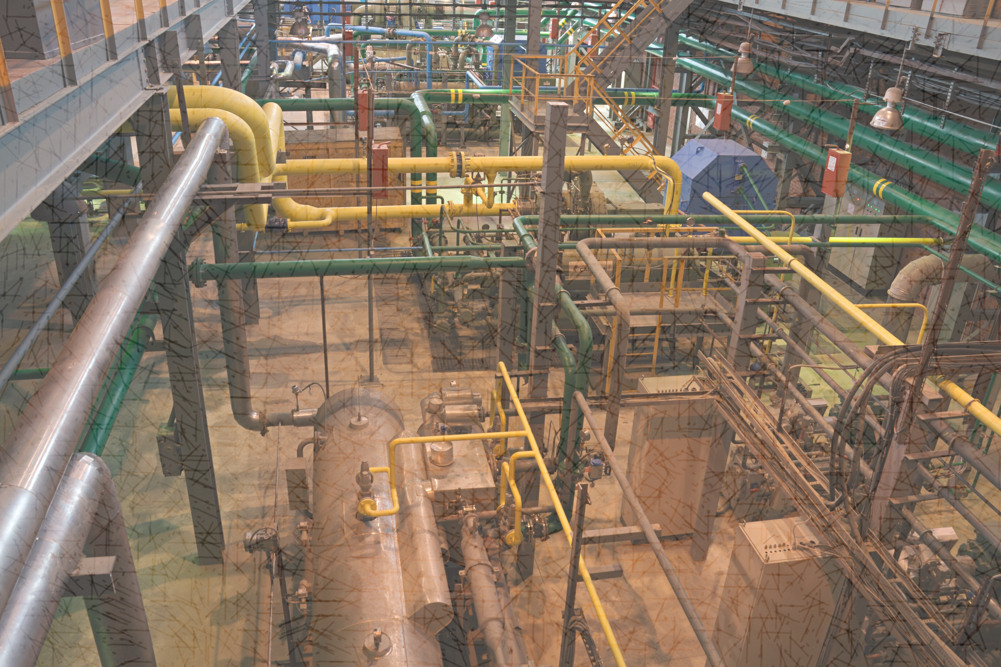
CASE
STUDY #463
Non-Saleable Natural Gas Processing Technology Research
ABOUT THE CLIENT
Industry | Oil & Gas
Revenues | $350 billion
Employees | 65,000
Location | Middle East
BSI Service or Solution | Scientific Research
Key Challenges In-place gaseous hydrocarbons contained high levels of nitrogen, carbon dioxide and hydrogen sulfide, and were consequently non-saleable. | Why BSI was Selected Track record of researching and analyzing complex technologies Ability to evaluate technical challenges from a business perspective Expertise in upstream oil & gas operations
Project Scope Investigated approaches to local (in the oil or gas field) processing and economic recovery: Technologies: Membranes Nanotechnology Absorption Adsorption Biological Applications: Claus+ Improvements Pre-Extraction Sub-quality Gas Power Generation Nitrogen Separation Bio-Desulfurization | Project Approach Scanned emerging technologies that could be integrated with conventional gas treatment process such as the Claus process Identified non-cryogenic process routes for gas processing separation of contaminant gases. Assessed the viability of gas-fed electric, heat and power generation technologies capable of operating on sub-quality natural gas.
Financial Benefits Realized Evaluated each technology and application's short-term and long-term potential for capital cost reduction and operating reduction | Operational Benefits Realized Evaluated each technology and application's short-term and long-term potential for processing performance (yield and quality) and operating reliability.

