Slide 1


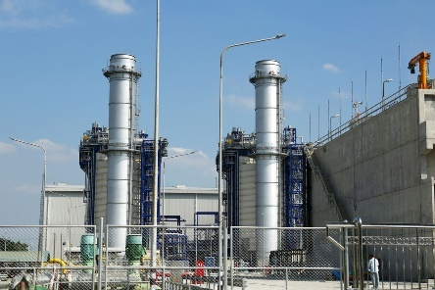
CASE
STUDY 451
Electricity Value Chain Case Study
ABOUT THE CLIENT
Industry | Electric and Gas Utility
Revenues | $32 billion
Employees | 32,000
Location | Europe
BSI Service or Solution | Value Chain Cost Engineering
"Thank you again for letting us learn from your work."
– Chief Procurement Officer
Key Challenges Budget was in deficit due to rising raw material costs Corporate agreements were short-term, transactional, and loose Suppliers expected an easy negotiation and routine price increases | Why BSI was Selected Prior experience in electricity value chain analysis Track record of impressive savings from sourcing projects Fact-based approach Analytical depth and tools to analyze value-added
Project Scope All US operations (6 operating companies) Capital and expense items All power generating and inventory stocking locations | Project Approach Analysis of client expenditure by source Analysis of suppliers’ businesses, trends, and profitability Preparation of economical strategies Contract renegotiations Finalization of terms and conditions
Financial Benefits Realized Reduced the Levelized Cost of Electricity 24% reduction of cost of purchased materials and services Additional rationalization of the associated inventory and manpower | Operational Benefits Realized 75% reduction in the number of suppliers Standardized products and pricing across operating companies reduced management overhead

