Slide 1
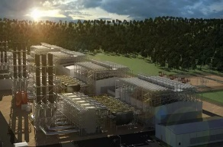

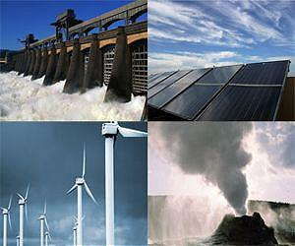
CASE
STUDY 449
“Regulatory Impact Analysis” Case Study
INECC – National Institute of Ecology and Climate Change
Industry | Government entity – Climate Change
Revenues | $3 to S300 billion
Employees | 2,000 to 80,000
Location | US and Europe
BSI Service or Solution | Expert Witness Service
Project Description Comparative analysis of the costs, value added, and stakeholders involved at each stage of the value chains of 4 power generating technologies in Mexico. Calculated the impacts of each technology over other sectors of the economy, the value created at each stage of the value chains, supplier concentration, and levelized cost of electricity.
Key Challenges Newly implemented Energy Reform bringing a great deal of uncertainty Rapidly changing market Lack of transparency on detailed cost information | Why BSI was Selected Deep experience in economic analysis of energy technologies Decision-making tools and processes to help evaluate complex technology and economic trade-offs Intimate familiarity with the major project developers and suppliers involved
Project Scope Utility-scale Solar PV Utility-scale Wind Farms Geothermal Power Plants Combined Cycle Power Plants | Project Approach Stakeholder interviews Statistical analysis Economic modelling Policy recommendation
Benefits Realized Thorough understanding of the detailed country’s cost structure for each technology analyzed leading to policy recommendations to incentivize the most cost effective renewable technologies. Detailed characterization of the value created at each stage of the value chain per technology leading to local value chain developments such as increased employment Understanding of the interactions between each energy technology and other sectors of the Mexican economy, allowing the government to align policy actions for different sectors

