Slide 1


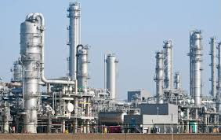
CASE
STUDY 441
Petrochemical Capital Project Management Process Optimization
ABOUT THE CLIENT
Industry | Petrochemicals
Revenues | < $10 billion
Employees | 1,500
Location | Middle East
BSI Service or Solution | Capital Project Mgmt
Key Challenges Client had always relied on a Project Management Consultant (PMC) to oversee capital projects, which was very costly and prevented the organization from building the requisite skills in-house. | Why BSI was Selected BSI brought the leading world experts in capital project management to the project. Our experts had 30 years of experience each, whereas the competitors had only 15-20. BSI was intimately familiar with process industries in Saudi Arabia, which was relevant to the procedures manuals as well as to the dynamic of working with the client team.
Project Scope Project management capabilities Cost Estimation Scheduling Assurance Health Safety & Environmental Assurance Construction Management Procurement Deliverables were customized to the needs of three unique capital project departments: Megaprojects, Third Party Projects, and Site Projects. | Project Approach Conducted interview with all departments Mapped key processes Identified gaps Recommended improvements Documented all processes in Procedures Manuals
Financial Benefits Realized The ability to bypass Project Management Consultants offered the potential to save up to 12% of project capital cost. On a $1 billion project, this would save $120 million. | Operational Benefits Realized The project gave the client the tools to save 10% or more on capital projects through value engineering and more consistent procurement practices Clearer roles and responsibilities (RACI) across departments improved response time and made project management more competent and precise.

