Slide 1

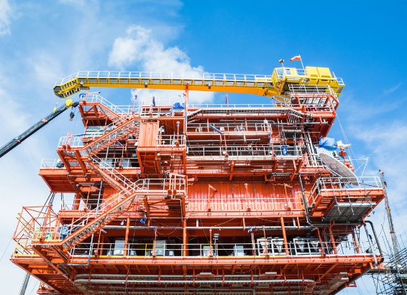
CASE
STUDY
Confidential Saudi Arabian Client
Kurdistan Drilling Client
ABOUT THE CLIENT
Industry | Oil and Gas
Revenues | $44 billion
Employees | 24,000
Location | Kurdistan, Algeria, and Iran
BSI Service or Solution | Business Process Management
Key Challenges High Non-Productive Time (NPT) Long lead times for equipment Lack of best practice HSE Language barriers with workforce | Why BSI was Selected Oil & gas supply chain experience Proven track record of performance improvement Prior experience in country
Project Scope Upstream exploration and production Surface and subsurface (under and over the rotary table) Suppliers from America and China Warehouses onsite, offshore, and around the world | Project Approach Streamlined operations Established operational KPIs Mandated performance standards for suppliers Mobilized tools and materials from global supply based to drill site, onshore and offshore
Financial Benefits Realized 5-10% reduction in service contract costs (savings through corporate master service agreements) 5% savings from standardization of casing and tubing | Operational Benefits Realized 12% increase in uptime to 96% 15% increase in tools & equipment availability to 99% (minor 15% increase in personnel competency, to 95% 20% decrease in lost time due to injuries Quality improvements Rate of penetration improvements

