Slide 1
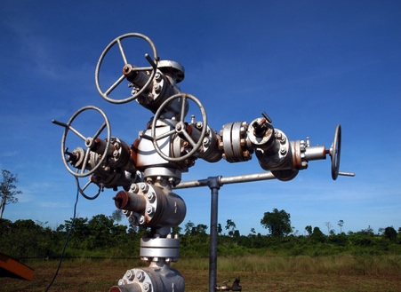
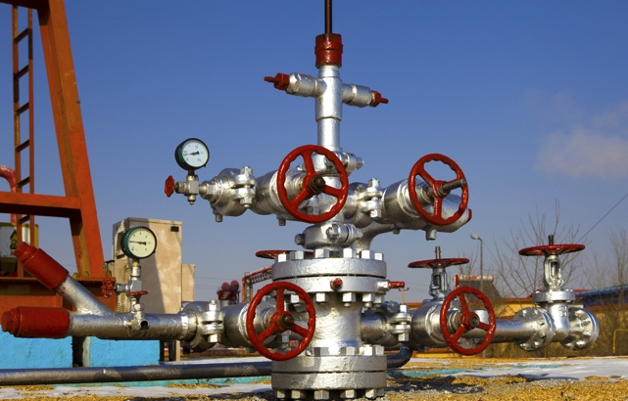
CASE
STUDY
Confidential Saudi Arabian Client
Oil & Gas Producer
ABOUT THE CLIENT
Industry | Oil and Gas
Revenues | $ billion
Employees | ~100,000
Location | Worldwide
BSI Service or Solution | Upstream Technology Research
Key Challenges Downtime due to equipment fatigue Lost drilling days Loss of production and revenue | Why BSI was Selected Deep knowledge of wellhead systems Cutting edge technology research
Project Scope Xmas trees Wellhead systems | Project Approach Increase reliability and uptime in fatigue-prone zones
Financial Benefits Realized 90% increase in production rates | Operational Benefits Realized 100% increase in number of drill days Expanded options for more drilling or workovers before fatigue affected production

