Slide 1

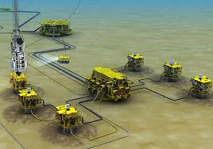
CASE
STUDY
Confidential Saudi Arabian Client
National Oil Company
ABOUT THE CLIENT
Industry | Oil and Gas
Revenues | $100+ billion
Employees | 85,000
Location | Europe & Middle East
BSI Service or Solution | Supply Chain Improvement
Key Challenges Subsea installations were costly and time-consuming Limited supply base for critical technologies | Why BSI was Selected Oil and gas supply chain experience Deep knowledge of supply base and contracts at National Oil Companies
Project Scope Offshore installations Shallow water (less than 500 feet of water depth) North Sea Potential for application in other regions | Project Approach Using surface wellheads on a platform rather than subsea wellhead installations
Financial Benefits Realized 25% potential savings on upfront cost 20-30% potential reduction in capital expenditures compared to a subsea installation | Operational Benefits Realized Quicker setup than conventional subsea wellheads and production systems Changed competitive dynamics with existing supply base, positioned client for negotiated savings

