Slide 1

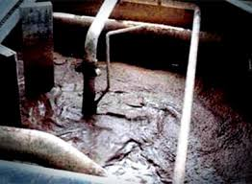
CASE
STUDY
Confidential Saudi Arabian Client
National Oil Company
ABOUT THE CLIENT
Industry | Oil and Gas
Revenues | $80 billion
Employees | ~100,000
Location | Middle East
BSI Service or Solution | Strategic Sourcing
Key Challenges Cost reduction targets Technology leadership goals | Why BSI was Selected Focus on upstream equipment and services Knowledge of specialized suppliers of muds, chemicals, and well services Expertise in supply chain cost reduction through strategic procurement
Project Scope Drilling lubricants Solvents Contracted drilling services | Project Approach Increasing Rate of Penetration and production levels through new chemical formulations of drilling fluids Leveraging supply market developments, especially a joint venture of two niche drilling fluids suppliers which had developed a new combined drilling fluid and solvent
Financial Benefits Realized 15% increase in hydrocarbon production rates $30m per well potential increase in production | Operational Benefits Realized Up to 15% higher Rate of Penetration

