Slide 1

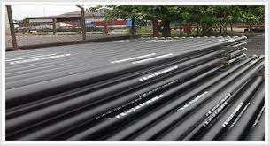
CASE STUDY
#434
Confidential Saudi Arabian Client
Oil & Gas Producer
ABOUT THE CLIENT
Industry | Oil and Gas
Revenues | $50 billion
Employees | 15,000
Location | US and Australasia
BSI Service or Solution | Logistics Optimization
Key Challenges Long materials supply lead times drove excess inventory requirements and stocking problems | Why BSI was Selected Prior experience with integrated supply of pipe, casing, and tubing
Project Scope Casing & Tubing US and Australian distribution networks | Project Approach Reengineer logistics of supply to reduce inbound lead times Vendor Managed Inventory
Financial Benefits Realized 4% inventory savings | Operational Benefits Realized 80% reduction in delivery lead times (7-10 days compared to 8-10 weeks on certain shipments

