Slide 1

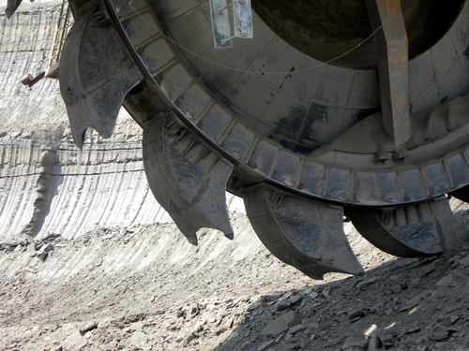
CASE
STUDY 431
Staff Competency Assessment and Rating
ABOUT THE CLIENT
Industry | Specialty Minerals
Revenues | $1.5 billion
Employees | 3,000
Location | United States
BSI Service or Solution | Staff Assessment
Key Challenges Catastrophic budget overrun highlighted deficiencies in staff competency at many levels Inbreeding and low turnover resulted in a lack of objectivity and knowledge around marketplace and competitive best practices No training and development; perpetuation of previous practices | Why BSI was Selected Supply chain expertise Process industry focus Audit and assessment frameworks
Project Scope Organization mission, vision, objectives, targets, and organization to achieve them All operations personnel Management and individual contributors All plants worldwide, with initial focus on US operations Group and individual competency | Project Approach Interviewed all staff Rated individual competence, strengths, weaknesses, and training requirements, using maturity matrices and best practice assessment tools Suggested new hires and outplacements to address short-term and long-term gaps Recommended individual and collective organization development initiatives, including training, development, monetary and non-monetary incentives, and compensation realignments
Financial Benefits Realized $2.8 million savings realized, which would not have been possible without staff alignment and collaboration Increased staff productivity and efficiency | Operational Benefits Realized Dramatically increased accountability Alignment around executive-endorsed goals and increased corporate competitiveness Enabled a cost-saving consulting engagement

