Slide 1


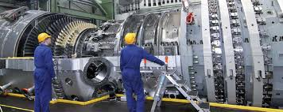
CASE
STUDY 417
“Market Entry Strategy” Case Study
“The US market is so big that we didn’t know where to start."
– Business Manager
ABOUT THE CLIENT
Industry | Turbine Services
Revenues | $7 billion
Employees | 40,000
Location | Europe
BSI Service or Solution | Market Entry Strategy
Key Challenges The client lacked visibility and major contract wins in specific geographic markets The size of potential market segments was un-quantified The client’s “sweet spot” versus competitors was unclear The minimum scale to compete, and associated investment, was unknown The potential for partners to accelerate market entry was uncertain The client’s value proposition needed to be customized to fit high-potential market niches | Why BSI was Selected Prior experience in turbines and turbine services Established BSI relationships that permitted BSI to uniquely gain objective perceptions of the client’s capabilities Presence in industry networks, conferences, and trade shows, which allowed rapid gathering of high-quality “inside” information
Project Scope Power generation turbine repair and refurbishment services, including: Blades Diaphragms, nozzles, and vanes Stationary components (e.g., diffusers) | Project Approach In-person interviews of existing and potential customers Assessment of competitive positioning Development of market entry strategies, considering scale to compete, barriers to entry and key success factors Evaluation of selected potential partners
Operational Benefits Realized More factual and productive dialogue across business units and divisions regarding US market potential and strategies to penetrate it Improved leverage of existing sales and operations activities through higher-value sales targets and coordination efforts | Financial Benefits Realized Quantifiable growth potential that could be achieved through an initiative to align with specific market segments, applications, and partners

