Slide 1

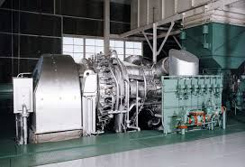
CASE
STUDY
Gas Turbine Cost Estimating
ABOUT THE CLIENT
Industry | Oil & Gas
Revenues | Approx. $50 billion
Employees | 100,000+
Location | Europe
BSI Service or Solution | Component Cost Estimating
Key Challenges OEM was quoting high over the market price Unique order characteristics (remote location, installation, and multiple units in the same order) made cost comparisons seemingly impossible Engineering specifications favored a specific supplier | Why BSI was Selected Knowledge and experience with the equipment Proven track record of quantifying equipment acquisition costs Clear, detailed process and unequivocal data that could be used in negotiations with the supplier
Project Scope Equipment cost with all accessories, plus bench testing, delivery and installation and commissioning costs “Local content” suppliers for manufacturing of component parts and spares Payment schedule and terms | Project Approach Cost benchmarking Cost modeling, including baseline costs, parametric comparisons, and sensitivity analyses Estimation of “normal” lead time Adaptation of costs to local (“in-country”) conditions Presentation of detailed cost estimate
Financial Benefits Realized 25% price overcharge identified and supported with facts and defensible benchmark figures Negotiations were able to capture the equivalent value of the overcharge | Operational Benefits Realized Consultant involvement helped avoid a large distraction from ongoing procurement work for the overall project Unbiased and credible benchmark supported negotiations

