Slide 1

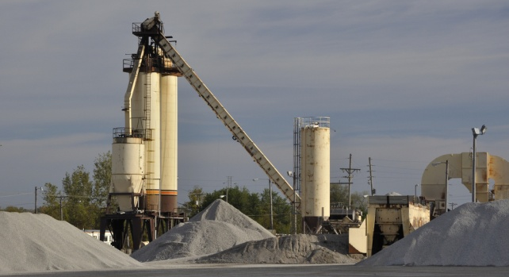
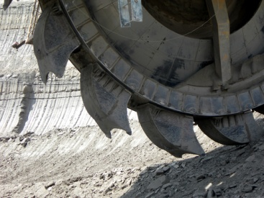
CASE
STUDY 412
Rare Earth Supply Chain Solution
"This is excellent work."
– Director of Purchasing
ABOUT THE CLIENT
Industry | Chemicals
Revenues | $3 billion
Employees | 5,000
Location | USA
BSI Service or Solution | Supply Chain Solution
Key Challenges One country representing over 95% of the world’s supply for several minerals cut export allowances by 75% and increased export taxes by 25%, creating a drastic shortage of material. Prices of the mineral rose 20% - 700% worldwide. The client’s tight specifications limited the number of potential processors. Supply was very high-priced and also uncertain. | Why BSI was Selected International industrial materials supply chain expertise Chinese language skills and resource network Trusted economic forecasting model Sourcing expertise Clear, simple, and pragmatic style delivers useful recommendations Proven history of performance with the client organization
Project Scope Sourcing of selected rare earths Processing / tolling US, Canada, China, and alternative countries | Project Approach Identify suppliers capable of producing at the desired purity level Screen international distributors, importers and partners to design an optimal global supply chain Identify and evaluate alternatives Develop sourcing strategies and recommendations
Operational Benefits Realized Immediate supply assurance through the use of a second, highly qualified supplier Resources that had been waylaid to deal with the supply crisis were freed up to resume normal duties. Internal alignment around the chosen path | Financial Benefits Realized Purchasing leverage gained through additional supply options Medium and long-term price stability assured through a plan to develop two additional strategic sources 25:1 payback expected on consulting expenditure

