Slide 1
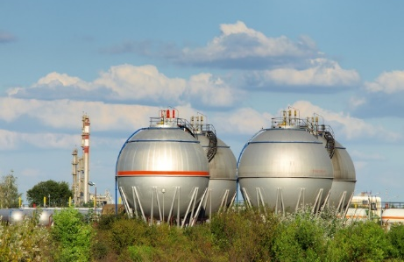
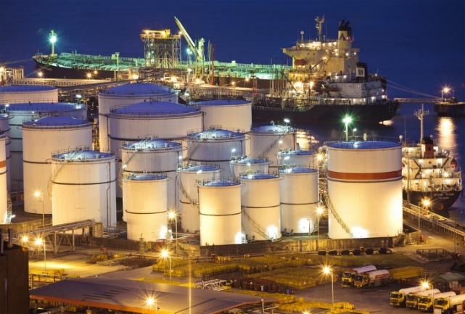
CASE
STUDY
Liquids Terminal Cost and Price Analysis
ABOUT THE CLIENT
Industry | Oil and Gas
Revenues | $100 billion
Employees | 140,000
Location | Latin America
BSI Service or Solution | Cost Estimation
Key Challenges Larger tank complex than had been previously built in the region created large price uncertainty for budgeting purposes Construction methods and expatriate staffing created large differentials in potential cost Price premium based on country risk exacerbated price uncertainty | Why BSI was Selected Cost modeling and benchmarking expertise Deep technical knowledge of tanks, tank farms, and oil and gas processing terminals Cost engineering expertise Proven supply chain cost reduction capability
Project Scope Civil works Piping Instrumentation and controls Equipment (SCADA, vessels, pumps, etc.) Logistics, transport and field costs Contingencies and construction overhead costs | Project Approach Developed a database of contracts Analyzed and normalized the contracts to quantify key parameters Developed and refined incremental costs by significant cost driving parameters Analyzed local vs. international labor costs to achieve lowest cost Wrote a specific cost engineering manual
Financial Benefits Realized Higher throughput Greater terminal efficiency Higher ROA | Operational Benefits Realized This analysis helped the client decide on the most cost-effective specifications (number of tanks, speed of processing facilities, type of equipment, etc.)

