Slide 1

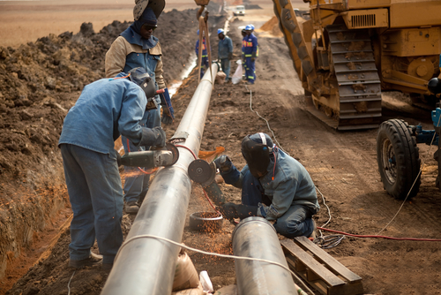
CASE
STUDY
Pipeline Cost Benchmarking and Modeling Case Study
ABOUT THE CLIENT
Industry | Oil & Gas
Revenues | Approx. $100 billion
Employees | Approx. 80,000
Location | Americas
BSI Service or Solution | Project Cost Estimating
Key Challenges EPC firms were charging above-market prices for pipeline construction due to in-country conditions The client wanted benchmark costs for similar pipelines to negotiate the prices down to market levels No pipelines were exactly the same, complicating cost comparisons The price of steel changed dramatically over the construction time horizon | Why BSI was Selected Industry expertise in pipeline construction Detailed pipeline cost model Clear “reference projects” that left no ambiguity about the specifications of the benchmark projects or the estimated cost Economic data and models that could “normalize” the cost of other pipelines to the one being proposed
Project Scope “All-in” cost: Engineering, procurement, and construction costs, plus profit and contingencies Detailed cost break-outs Sensitivities for parameters such as pipe diameter and thickness, terrain type, soil type, single vs. dual pipelines, etc. 10 years of pipeline project comparisons, from 50 to 5000 km long | Project Approach Cost benchmarking Cost modeling, including baseline costs, parametric comparisons, and sensitivity analyses Analysis and reconciliation of discrepancies Adaptation of costs to local (“in-country”) conditions Presentation of detailed costs
Financial Benefits Realized $9.6 billion savings on $40 billion of potential expenditure ($230b capex “vision”) 24% savings on selected categories of equipment Payback: 380:1 | Operational Benefits Realized Facilitated capital budgeting Opened up an intelligent dialogue with construction firms Clarified which aspects could be done locally at economical cost levels, thereby increasing local content

