Slide 1


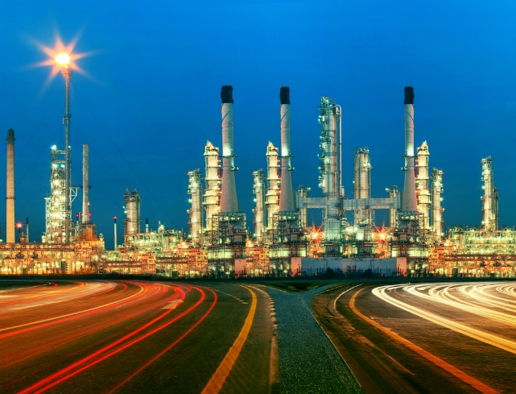
“Refineries and Process Unit Cost and Price Analysis”
ABOUT THE CLIENT
Industry | Oil and Gas
Revenues | $100 billion
Employees | 140,000
Location | Latin America
BSI Service or Solution | Cost Estimation
Key Challenges Potential investments included a wide range of process units and end product possibilities Price and cost varied with complexity and size, but “rules of thumb” were too inaccurate for the size of investment under consideration | Why BSI was Selected Cost estimation expertise Deep technical knowledge of refineries and processing routes Cost engineering expertise Proven supply chain cost reduction capability
Project Scope Distillation Capacity, Vacuum Distillation, Thermal Processes, Coking, Catalytic Cracking, Catalytic Reforming, Catalytic Hydrocracking, Catalytic Hydrorefining, Catalytic Hydrotreating, Alkylation, Polemerization, Aromatics, Isomerization, Lubes, Asphalt, Hydrogen (MCFD), Oxygenates, and Sulfur Extraction | Project Approach Developed a database of projects Analyzed and normalized actual completed cost Developed an accurate model for forecasting project cost by improving on a “Nelson Complexity Index” concept Provided a framework for a model that would select the optimal project based on accurate revenue and capital cost
Operational Benefits Realized This analysis helped the client decide on the most cost-effective type of processing units to build | Financial Benefits Realized Maximum ROA

