Slide 1

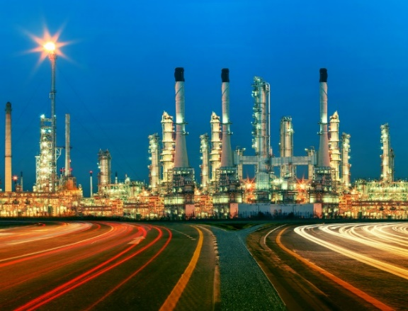
CASE STUDY
#0222
Refinery Process Unit Cost and Price Analysis
ABOUT THE CLIENT
Industry | Oil and Gas
Revenues | $100 billion
Employees | 140,000
Location | Latin America
BSI Service or Solution | Cost Estimation
Key Challenges Potential investments included a wide range of process units and end product possibilities Price and cost varied with complexity and size, but “rules of thumb” were too inaccurate for the size of investment under consideration | Why BSI was Selected Cost modeling and benchmarking expertise Deep technical knowledge of refineries and processing routes Cost engineering expertise Proven supply chain cost reduction capability
Project Scope Distillation Capacity Vacuum Distillation Thermal Processes Coking, Catalytic Cracking Catalytic Reforming Catalytic Hydrocracking Catalytic Hydrorefining Catalytic Hydrotreating | Project Approach Developed a database of projects Analyzed and normalized actual completed cost Developed an accurate model for forecasting project cost by improving on a “Nelson Complexity Index” concept Provided a framework for a model that would select the optimal project based on accurate revenue and capital cost
Financial Benefits Realized Maximum ROA | Operational Benefits Realized This analysis helped the client decide on the most cost-effective type of processing units to build
  Alkylation
  Polymerization
  Aromatics
  Isomerization
  Lubes
  Asphalt
  Hydrogen (MCFD)
  Oxygenates
  Sulfur Extraction

