Slide 1
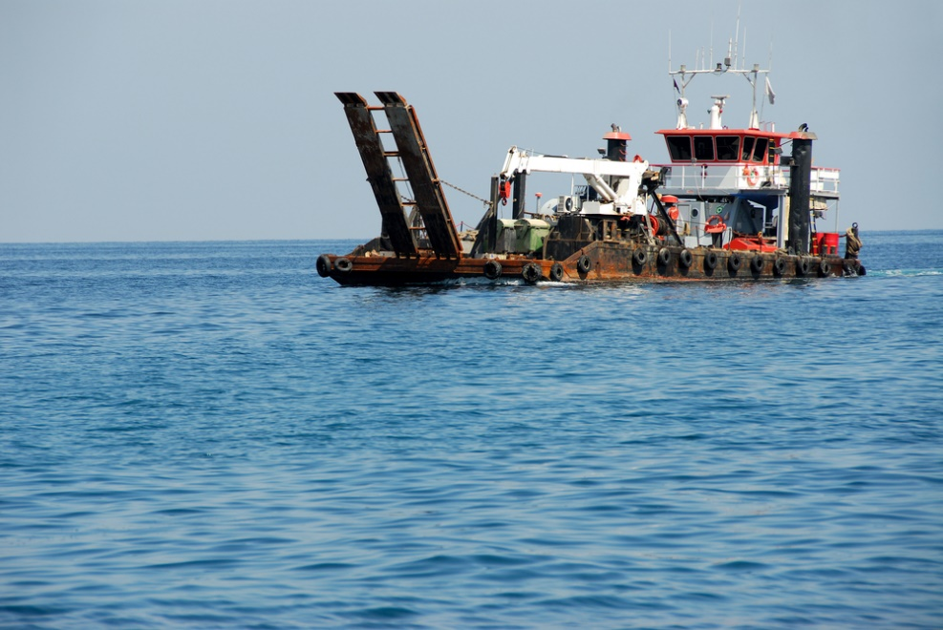

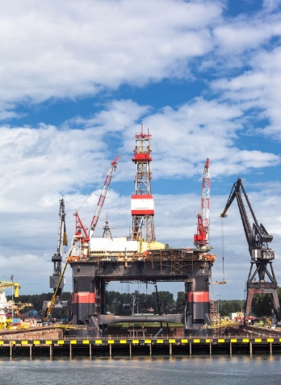
“Rigs Cost and Price Analysis”
ABOUT THE CLIENTS
Industry | Oil and Gas
Revenues | $100 billion
Employees | 140,000
Location | Latin America
BSI Service or Solution | Cost Estimation
Key Challenges Diverse choice of rig technologies based on varying water depths, formation characteristics, power options, etc. Rapidly changing prices of rigs in the world market Price premium based on country risk | Why BSI was Selected Cost estimation expertise Deep technical knowledge of rigs Cost engineering expertise Proven supply chain cost reduction capability
Project Scope Land rigs Semi-submersible rigs Drilling barges | Project Approach Developed a database of recent contracts Analyzed and normalized the contracts to obtain quantifiable parameters Developed and refined incremental costs by significant cost driving parameters
Operational Benefits Realized This analysis helped the client decide on an optimal technology for the needed applications The analysis helped the client correctly specify and size the rigs. | Financial Benefits Realized Higher throughput per rig Greater rig efficiency More profit per rig Higher ROI

