Slide 1
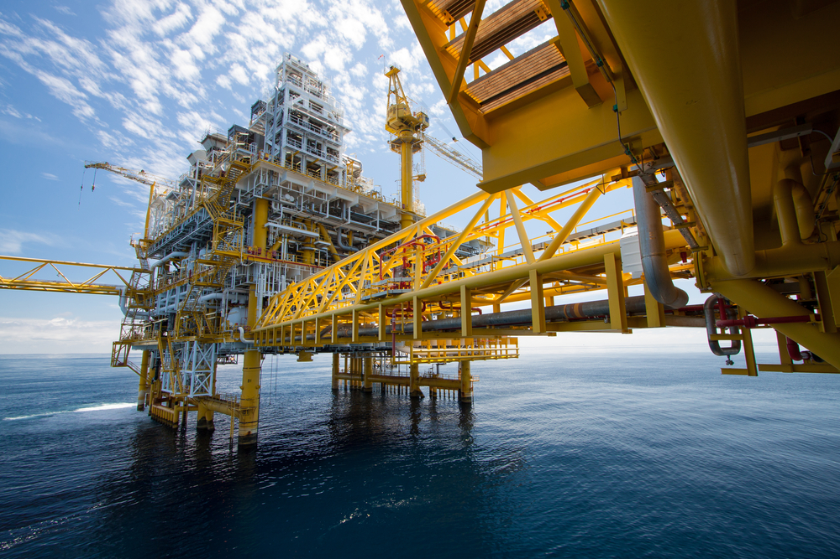
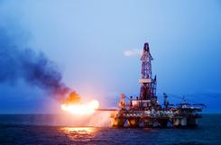
CASE
STUDY 191
Supplier Competitive Analysis & Contracting Strategy
Expert Witness Case
“Your analysis held up to intense scrutiny."
Legal Counsel
ABOUT THE CLIENT
Industry | Oil and Gas
Revenues | $300 billion
Employees | 80,000
Location | US and Europe
BSI Service or Solution | Expert Witness Services
Key Challenges Severe accident that resulted in litigation Treble damages Independent assessment of reasonable economic damages Consulting witness | Why BSI was Selected Oil and gas supply chain experience Relevant economic and financial databases Leading edge supply chain modeling capabilities Proven accuracy and reliability Proven ability to explain complex supply chain problems clearly, simply, and objectively
Project Scope Oil & Gas capital project supply chains Oilfield equipment maintenance and repair Oilfield service contractors Rig leasing & rentals and services Offshore marine servicing Pipelaying and pipeline services | Project Approach Reconstructing value chain flows Analyzing and reconstructing financial statements Benchmarking operational data against “normal” Forensic analysis Baselines and forecasts
Financial Benefits Realized Reduction of liability | Operational Benefits Realized Closure to a decade-long disaster Public relations, brand & image improvement

