Slide 1

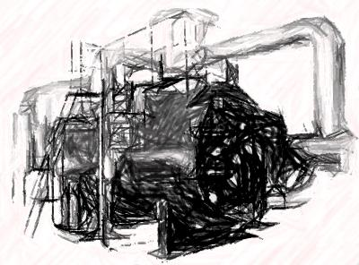
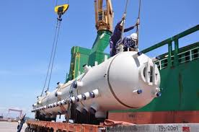
CASE
STUDY #187
“Market Repositioning” Case Study
“Our vision, mission, strategy, and implementation plan are clear and aligned now."
– Deputy Managing Director
ABOUT THE CLIENT
Industry | Energy and Infrastructure, with a focus on Oil, Gas, and Petrochemical Production Equipment
Revenues | $2 billion
Employees | 6,000
Location | Saudi Arabia
BSI Service or Solution | Business Strategy
Key Challenges Changes in the competitive landscape since the global recession rendered the old business model obsolete. Market focus and product offering were too narrow to appeal to major buyers, limiting account penetration and revenue growth Sourcing was high-cost Pricing was uncompetitively high Business was unprofitable | Why BSI was Selected Deep knowledge of oil, gas, and power companies’ requirements and buying behavior Strategic, analytical, and financial skill sets to structure and analyze strategic options across 6 industries, 10 product lines, 40 products, and 6 channels of distribution Technical capability across the range of current and potential products and services Combination of onsite and remote consulting team provided the desired degree of interaction and value
Project Scope Fluid Treatment Process Control Turbomachinery and related services Pressure vessels Heat exchangers Drilling tools Valves Pipeline services | Project Approach Market sizing and profiling Assessment of the current business model Development of key success factors and strategic options Evaluation of strategic options, including portfolio analysis Articulation of a winning business model and strategy Complete implementation planning, including organization structure, job descriptions, etc.
Operational Benefits Realized Revitalization of the business Improved morale Reduced staff turnover rate Re-emergence as a leader in the marketspace | Financial Benefits Realized 18% increase in projected operating margin Projected Return on Investment (ROI) among the highest in the holding company’s portfolio Decision to recapitalize the business for a 7-10 year horizon

