Slide 1


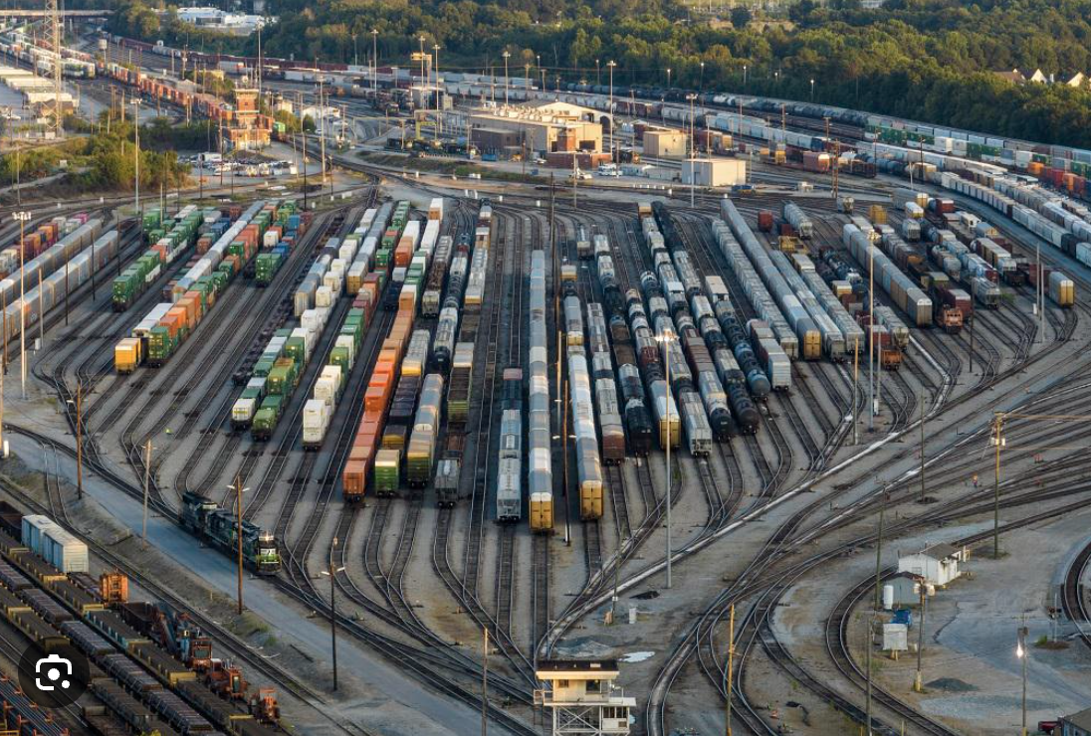
CASE
STUDY 122
Supplier Competitive Analysis & Contracting Strategy
“Transport Infrastructure Evaluation”
ABOUT THE CLIENT
Industry | Railroad
Revenues | $2 billion
Employees | 28,000
Location | Hong Kong, China
BSI Service or Solution | Financial Analysis
“Your analysis held up to intense scrutiny."
Legal Counsel
Key Challenges Growing ridership had exhausted existing right-of-way and rolling stock capacity Future growth required large-scale additions and new services Adequate transport infrastructure of the country’s principal export hub was central to the economic growth of China. | Why Boston Strategies was Selected Uniquely deep financial and management expertise in rail and shipping (at the time we were a subcontractor to a global consultancy.) Ability to mobilize a world-class team from Europe, America and Asia.
Project Scope Evaluation of capital investments in six infrastructure projects, including multiple megaproject new line and tunnel projects Privatization policy restructuring to attract foreign as well as domestic capital | Project Approach Evaluated a multi-billion dollar investment in a container train service from China to the Hong Kong harbor. Evaluated the viability of adding passenger trains and a light rail transit link to connect a series of “new towns” in the New Territories to Hong Kong/Kowloon Formulated a near-term breakbulk freight operations plan.
Financial Benefits Realized Developed business case for $6.7 billion of capital investments Secured approval for a major tunnel project Secured approval for a major new passenger rail line Negotiated lucrative rights agreements for right-of-way (e.g., parking lots, retail shopping malls, etc.) | Operational Benefits Realized Alleviated capacity constraints in shunting yards and at ports Allowed multiple new towns to commence construction with the certainty that rail infrastructure was forthcoming Facilitated the growth of processing and value-added industries on both ends of the proposed rail lines

