Slide 1


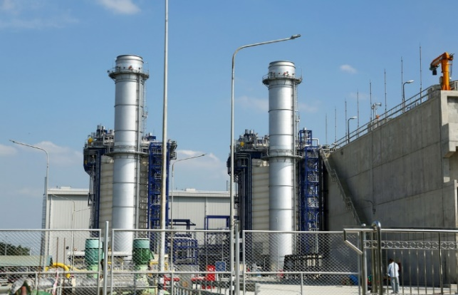
CASE
STUDY #74
Integrated Gasification Combined Cycle (IGCC) Gas Turbine Service Contract Negotiation
ABOUT THE CLIENT
Industry | Oil and Gas
Revenues | $200+ billion
Employees | 80,000
Location | Middle East
BSI Service or Solution | Cost and Price Intelligence
Key Challenges Power plant design relied heavily on a specific turbine OEM and service provider. Turbine acquisition and maintenance contract had not yet been negotiated, raising complications for exert price leverage given the design. A strategy was needed to interject price competitiveness and pressure into the remaining contracting process. | Why BSI was Selected Cost estimation and engineering expertise Technical knowledge of refineries and power plant technologies Proven ability to reduce cost with strategic suppliers
Project Scope Benchmarks of 23 IGCC (Integrated Gasification Combined Cycle) plants Construction, operating, and maintenance costs Adaptation and customization of gas turbines | Project Approach Conducted primary and secondary research Built cost structures from ground up and compared to actual bids, bottom-up, top-down and laterally Analyzed comparative lifecycle costs Toured plants and facilities Developed high-impact negotiating points
Financial Benefits (Potential) 20-30% cost savings through use of an independent (non-OEM) maintenance provider 20% savings potential from increasing maintenance intervals 10%+ savings on capital spares 5% cost savings from performing some maintenance in-house | Operational Benefits (Potential) Higher confidence in the strength and durability of the long-term contract with the key supplier Clearer operating mission, including better relationship between procurement and operations/maintenance

