Slide 1
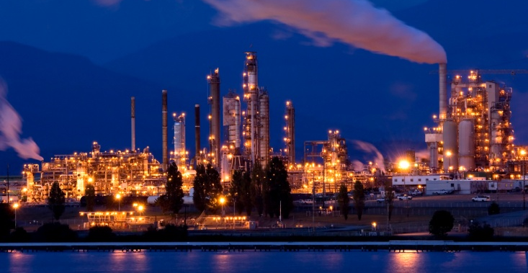
“Supply Risk Analysis and Mitigation” Case Study
"Your assessments were spot on."
– Capital Acquisition Director
"Exactly what we were looking for."
– Global Procurement Policy Coordinator
ABOUT THE CLIENT
Industry | Oil and Gas
Revenues | Hundreds of billions of dollars
Employees | Tens of thousands
Location | Middle East
BSI Service or Solution | Forward-Looking Supply Strategies Recommendations
Financial Benefits Realized $1.7 Billion+ (28%) Savings Identified, excluding production benefits $60+ billion including Production Benefits 1.0 - 1.4% reduction in Total Corporate Operating Cost 4.0 - 6.7% increased in Total Corporate Return on Assets 280:1 payback on consulting services | Operational Benefits Realized Quicker delivery of equipment by identifying pockets of supplier capacity Lower inventory through local sourcing and lead time reduction Deployment of newer technologies
Key Challenges Supplier price increases cost inflation Long lead time complex equipment enters production – plus, significant disparities in lead times and prices between buyers for similar products Lower production rates from outdated drilling, completion, and other technologies Shorter equipment life due to counterfeit products | Why BSI was Selected “Supply chain economists” Trusted economic forecasting model Fact-based, numbers-driven analysis Leading edge analytics Research/consulting synergies Thought leadership Clear, simple, and objective Proven accuracy and reliability Over 15 years of repeat engagements
Project Scope 200 engagements since 2006 $60 Billion of Capex Reviewed $6+ Billion of Annual Expenditure Studied in Detail 50 sourced categories in 10 groups of highly complex engineered equipment 1,500+ recommendations | Project Approach Economic modeling and forecasting Primary and secondary market intelligence Sourcing recommendations Quarterly reports Savings calculation tools

